Slide 1
Children’s Experience of Violence & What the Evidence Tells us Helps Keep them Safe
Gail Gibbons, Head of Change – Children’s Services & Neighbourhoods
Notes:
Gail

Slide 2
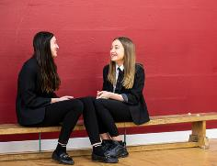
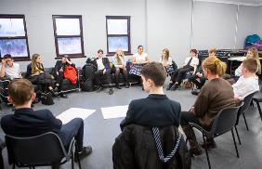
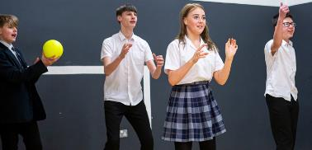
The Youth Endowment Fund
Our Vision
A world where no child becomes involved in violence.
Our Mission
To find what works and build a movement to put this knowledge into practice.

Slide 3
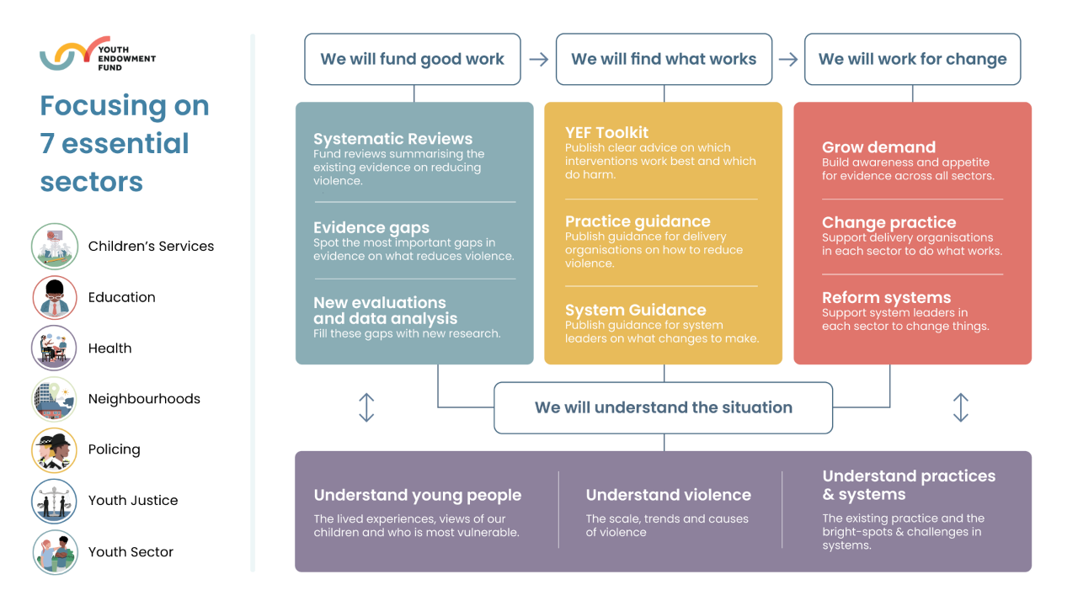

Slide 4
Children, violence and vulnerability 2024

Slide 5
Background to the survey
Different sources show different things about the nature of violence…
Police-recorded crime
Youth justice system
Hospital admissions
Surveys (e.g. CSEW - 1,528 10-15-year-olds)
Purpose of our survey is to provide….
Robust national estimates of the number of CYP affected by violence (victims, witnesses, perpetrators)
Greater clarity on which children are most affected by violence.
Provide more information on the context we operate in and the sectors that support CYP

Slide 6
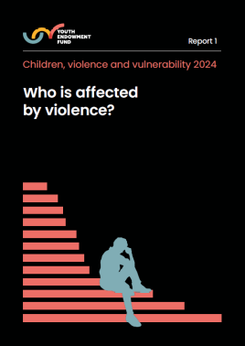
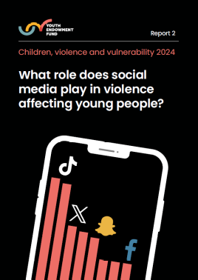
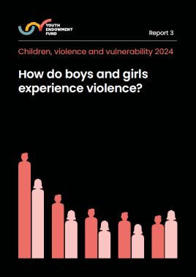
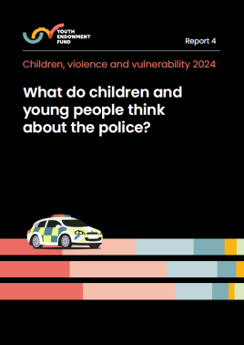
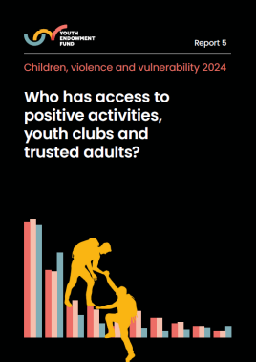
Our latest survey
This is our third annual survey. We surveyed over 10,000 13-17-year-olds across England and Wales.
The findings were split over five separate reports:
Overall prevalence of violence
Social media
Gender and relationships
Police (covered next time)
Positive activities, youth clubs and trusted adults (covered next time)

Slide 7
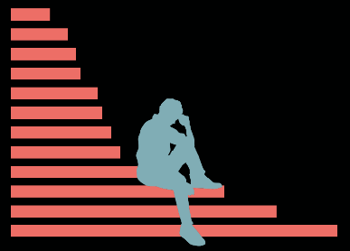
How common is violence?
A worrying minority of children continue to have direct experiences of violence.
A majority are exposed to violence on social media.
Relationship violence is common for both boys and girls.

Slide 8
How we measured violence
“By violent crime, we mean the use of force or threat of force against another person or people, for example punching someone, threatening someone with a weapon, or mugging someone. This also includes sexual assault, which is when somebody intentionally touches someone in a sexual way without their consent.”
Physical assault
Someone kicked, hit, pushed/shoved, or was physically violent in some way towards another person
Robbery
Someone used force or threats to steal or take something from another person.
Sexual assault
Someone intentionally touched another person in a sexual way, e.g. touching, grabbing or kissing, without their consent (permission). Both girls and boys can be sexually assaulted by either boys/men or girls/women.
Weapons
Someone used or threatened to use a weapon on another person.

Slide 9
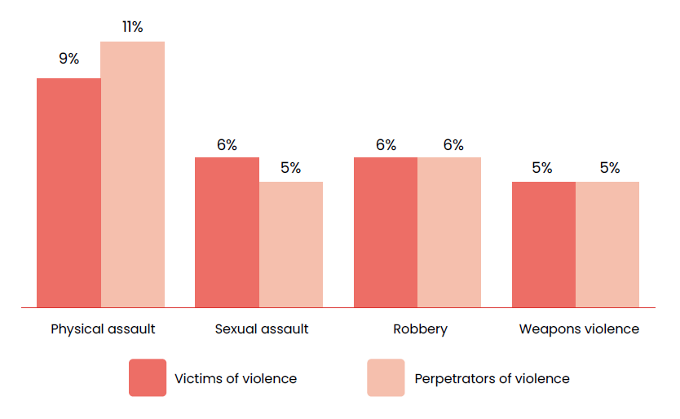
A worrying minority of children continue to have direct experiences of violence
20%
Proportion of 13-17-year-olds who were victims and perpetrators of violence in the past 12 months:
have been victims in the past year
16%
have perpetrated violence
27%
have been either victims or perpetrators
(equivalent to 960,000 13-17-year-olds)

Slide 10
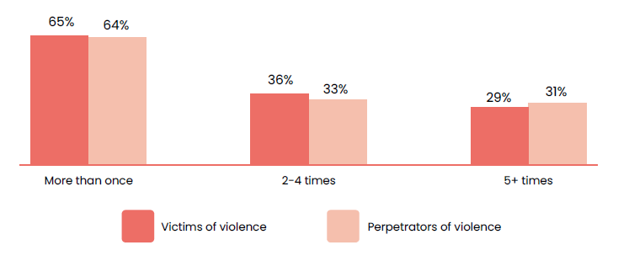
Most experience more than one incident
Proportion of 13-17-year-olds who were victims and perpetrators of violence who experienced more than one incident in the past 12 months:
61%
of victims experienced violence that resulted in physical injury
48%
of those who perpetrated violence say it resulted in physical injury

Slide 11
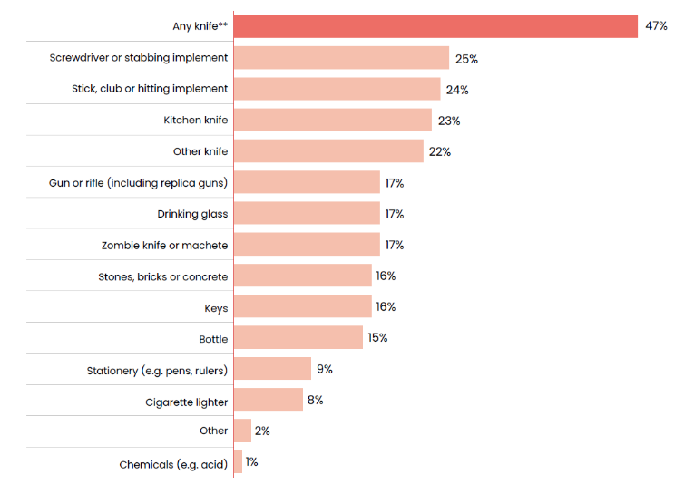
5% of children said they carried a weapon in the past year
Types of weapons carried by children who’ve carried one in the past year:
25%
of those carried a screwdriver or other stabbing implement
23%
carried a kitchen knife

Slide 12
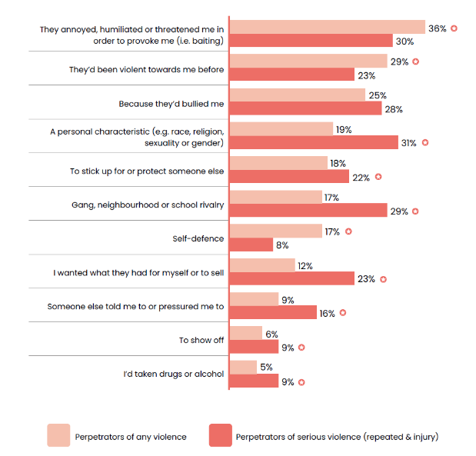
The leading reasons children gave for perpetrating violence were baiting and retaliation
<- Reasons children perpetrated violence

Slide 13
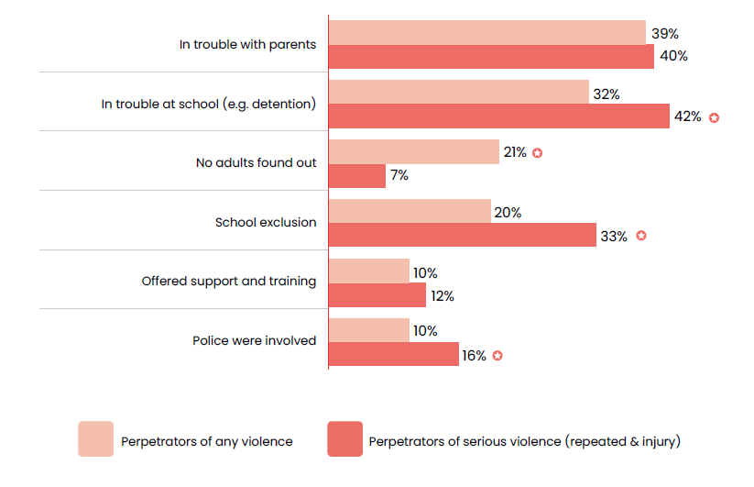
Most children perpetrating violence don’t receive support
Adults’ responses to children who perpetrated violence:

Slide 14
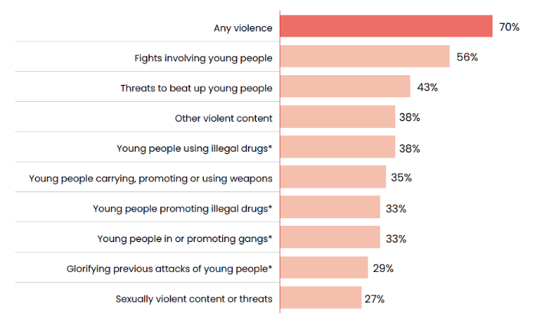
70% of teenage children have seen violence on social media in the past year
Proportion of children who’ve seen different types of content on social media in the past 12 months:
Users of certain platforms are more likely to see violence
44%
of TikTok users
43%
of X users
Platforms appear to be pushing content at children
6%
searched for it
25%
had it promoted to them by the platform

Slide 15
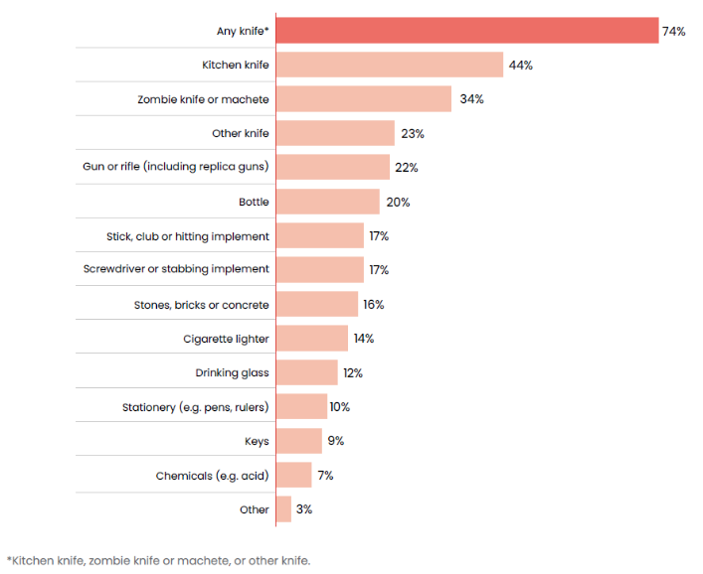
1 in 9 have seen zombie knives or machetes on social media
<- Types of weapons seen by children who’ve seen weapons online in the past 12 months

Slide 16
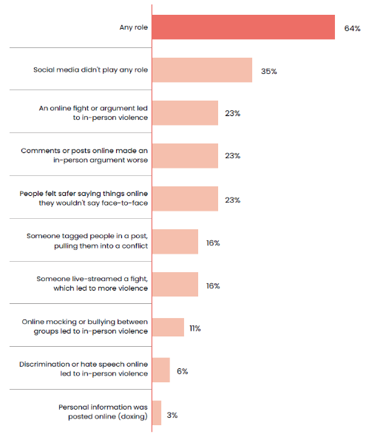
Two-thirds of children who perpetrated violence say social media played a role
<- Proportion of children who perpetrated violence who say social media played a role

Slide 17
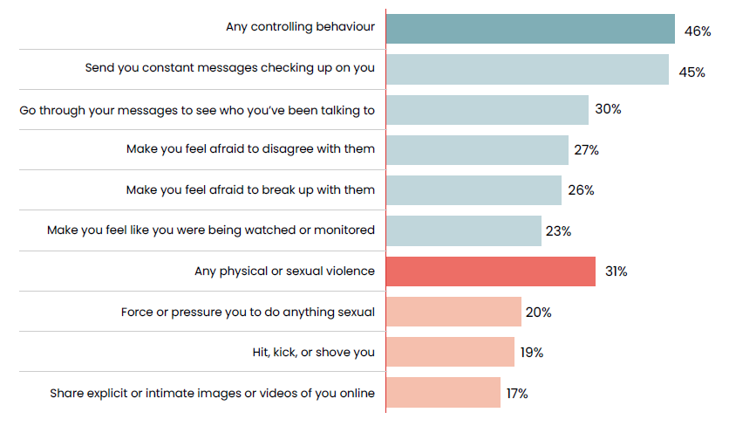
Half of children in relationships experienced violent or controlling relationship behaviours
Proportion of children in relationships who experience violent and controlling behaviours:
8.5%
of all 13-17-year-olds

Slide 18
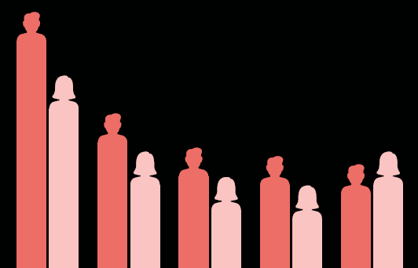
Who is affected by violence?
Younger children are more likely to say they’ve been affected by violence.
Violence is experienced differently by boys and girls.
Experiences of violence are concentrated among the most vulnerable.

Slide 19
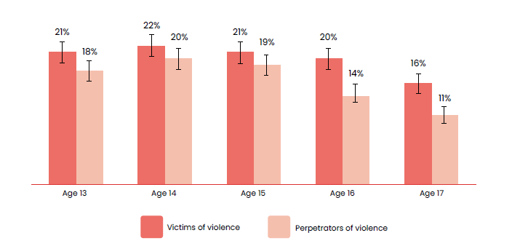
Younger children are more likely to be affected by violence.
Proportion of children who’ve been victims and perpetrators of violence in the past year by age:
47%
of 13-year-olds in relationships have experienced physical or sexual relationship violence
compared to
19%
of 17-year-olds in relationships

Slide 20
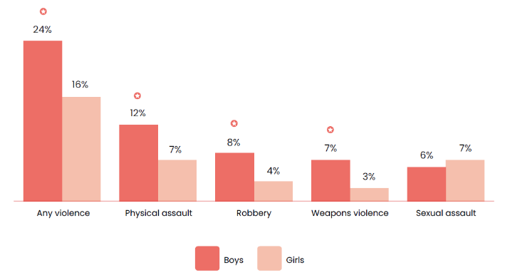
Boys are more likely to be involved in violence, but rates for girls are high as well.
Proportion of children who’ve been victims of violence in the past year by gender:
21%
of boys perpetrated violence vs 11% of girls

Slide 21
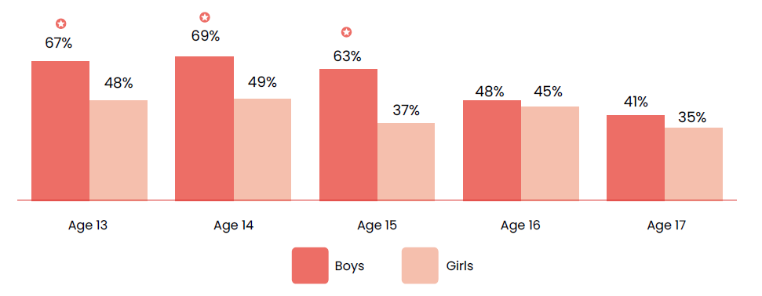
Relationship violence shows unexpected gender patterns
Proportion of children in relationships who’ve experienced any violent or controlling behaviour by age and gender:

Slide 22
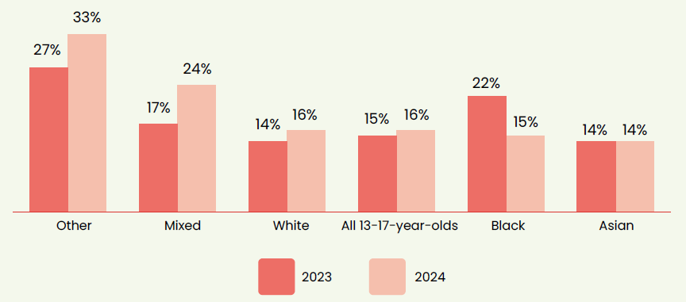
Experiences differ by ethnicity
Proportion of children who perpetrated violence this year compared to last year:
But looking at broad ethnic groups might obscure the results
13%
of Black African children say they perpetrated violence, compared to
20%
of Black Caribbean children

Slide 23
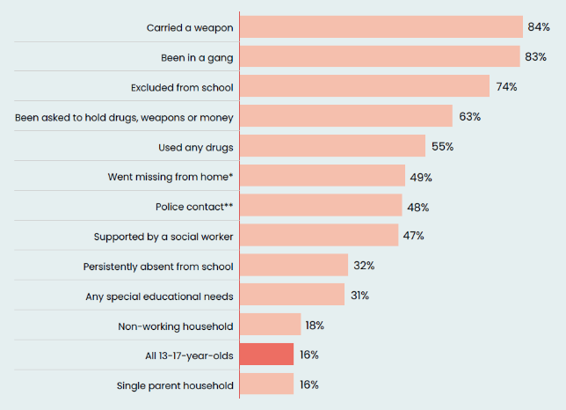
Experiences of violence are concentrated among the most vulnerable
Proportion of 13-17-year-olds who perpetrated violence in the past 12 months:
of children asked to hold drugs, weapons or money…
94%
have seen violence on social media
79%
of those in relationships have experienced violent or controlling relationship behaviours

Slide 24

How widespread are the effects of violence?
The majority of children feel the effects of violence.
Social media content impacts how safe children feel.
Some of these fears are putting them at greater risk.

Slide 25
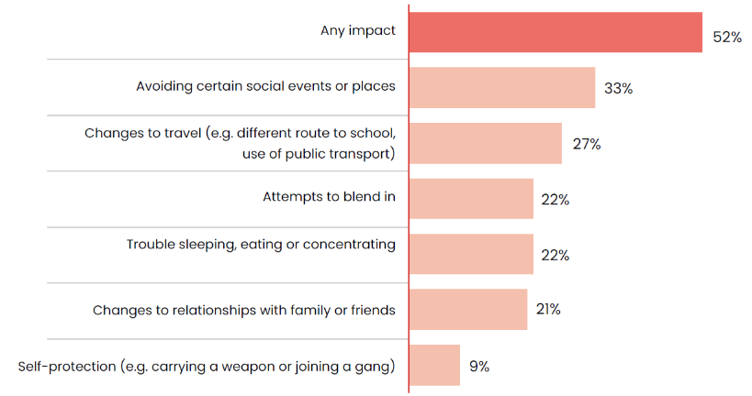
Two-thirds of children are worried about being the victim of violence
Proportion of 13-17-year-olds reporting day-to-day impacts of fears of violence:
52%
say fears led them to change their behaviour or impacted their wellbeing

Slide 26
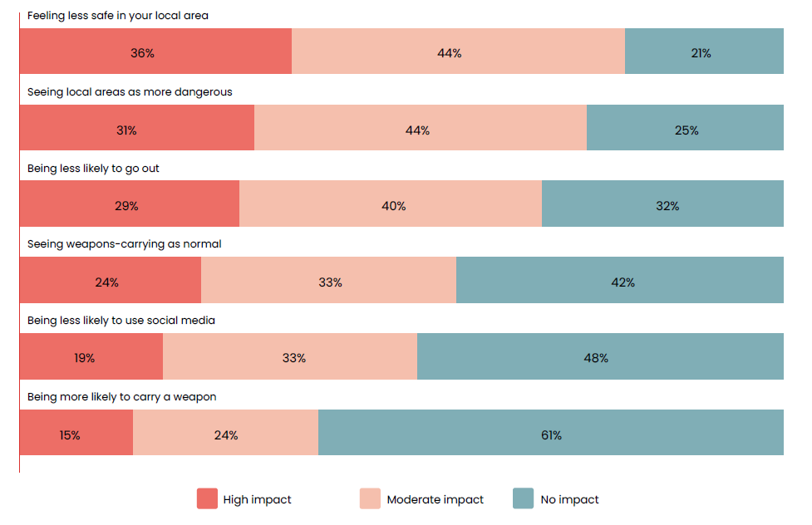
Social media content affects feelings of safety
Day-to-day impacts of seeing weapons content on social media:
80%
seeing weapons online say it makes them feel less safe in their area
68%
seeing weapons online say it makes them less likely to go out

Slide 27
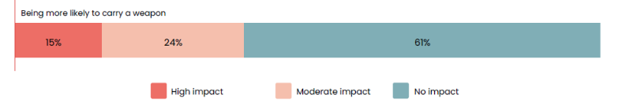
Some of these fears are putting children at greater risk
39%
of children who’ve seen weapons online say it has an impact on making them more likely to carry a weapon themselves
9%
of all children say they’ve done things to protect themselves like carrying a weapon or joining a gang

Slide 28
Introduction to the YEF Toolkit

Slide 29
What does the YEF Toolkit aim to do?
Summarise research making it accessible and actionable
Support professional decision making with ‘best bets’
Create a foundation for change
Notes:
Aims:
Summarise the Toolkit’s aims and introduce some key principles
Speaking notes
An online and free-to-access overview of existing research on approaches to preventing serious youth violence.
The focus is on approaches, interventions, programmes. Things that you can put in place. It doesn’t summarise research on what causes violence or people’s views on violence.
It’s in plain English, because we want this to be useful to everyone working with children – not the academics to produced the research.
We’ve tried to make it as accessible as possible. We involved practitioners in reviewing content and user testing the website. We had a group of young people who advised us on the language we use.
The Toolkit is a tool to support professional decision making.
We hope it will give a sense of the best bets – what has worked well in the past in other contexts – and this is a good starting point for thinking about what to do in a local context.
Applying the toolkit to the real-world problem will require careful professional judgement, consideration of local context, local strategic needs assessments, and evaluation of the impact of any action.
Our third aim with the Toolkit is to create a foundation for activities that will drive change. The Toolkit is a necessary but insufficient condition for change. Positive impact will be achieved by building partnerships that can bring the evidence to life.

Slide 30

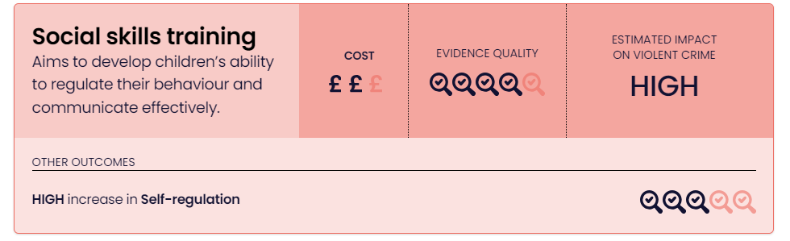
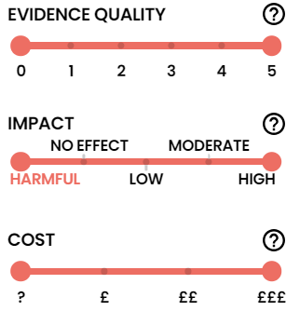
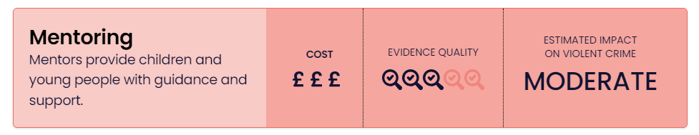
YEF Toolkit
An overview of existing research on approaches to preventing serious youth violence.
Notes:
On the front page you’ll see 32 different approaches each with their own summary card.
For each approach we show three pieces of information.
On the right hand side we provide an estimate of the average impact on protecting children against involvement in violence. The range includes High, Moderate, Low, No Effect, Harmful or Not known (?).
In the middle of the three ratings we have our evidence rating. This communicates the security of the evidence we have used to calculate the impact rating. It reflects our confidence in the impact rating.
If appropriate, add: We look at a) quality of the underlying review, b) the number of studies, c) the consistency of those studies, and d) whether those studies look directly at violence or at a protective/risk factor.
On the left hand side we provide a cost rating of 1 to 3 pound signs. The cost rating gives a simple, initial sense of the likely cost of the approach.
For some of the approaches we also give information about the evidence on other related outcomes, such as: bullying, behavioural difficulties, school exclusions. Those depend on the what the intervention was seeking to address.
4. You will also see on the left a series of filters – allowing you to choose if you want to look at only those with strong evidence, type of prevention, or settings, such as schools or custody.

Slide 31
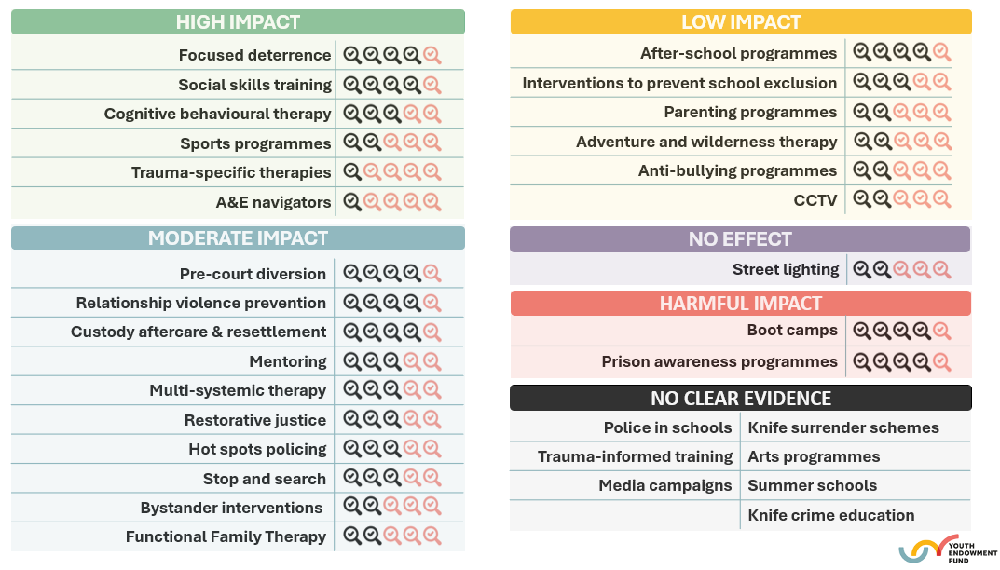

Slide 37


Summer employment programmes
What is it?
Paid work placements during the summer holiday, around 25 hours/week
Pre-work training, and coaching or mentoring
How might it work?
Diverting or distracting young people away from situations and peer groups that increase risk of violence, during a higher risk time of the year.
Development of skills, self-esteem, career aspirations.
Impact
High impact on violence during the summer
Low impact on violence longer term
Mixed outcomes for other crime types
Cost
High cost
Notes:
Headline impact rating based on 2 RCTs in Chicago and New York
Targeted at schools in high violence neighbourhoods, and families with higher social deprivation
What is it?
Various components of these programmes, including the pre-work training and skills development, coaching or mentoring, and development of positive relationships with fellow employees, may lead to increased self-esteem, confidence, maturity, emotion control, communication skills, responsibility, and time management. Improvements across these characteristics may reduce instances of violent or offending behaviour and improve future employment opportunities.
How might it work?
On average, summer employment programmes are likely to have a high impact on reducing violence during the summer. However, the research on summer employment programmes is weak, and these impacts are not maintained longer term. We also have very low confidence in our estimate because its based on two studies with high variation
Cost
On average, the cost of summer employment programmes is likely to be high.
The costs include programme coordination, recruitment of participants, delivery of pre-placement training, coaching or mentoring provision, administrative costs, and may include as contribution to participant wages.

Slide 38
Existing topics we’re scoping for updates this year
Social skills training Universal Targeted | School attendance Behaviour management Whole-school approach or supporting attendance | Pre-court diversion Outcome 22 Community resolution Conditional cautions
Sports programmes Team sports Combat sports | Cognitive Behavioural Therapy Clinical provision CBT techniques | Trauma-specific therapies Breakdown by types

Slide 39
New topics we’re scoping for adding to the Toolkit this year
Gang exit programmes | Interventions to prevent criminal exploitation | Poverty reduction interventions, e.g. cash transfers
The 'Cardiff Model' of multi-agency data sharing | Community sentences | Community level investment
Youth clubs | Detached youth work | Custody Navigators

Slide 40
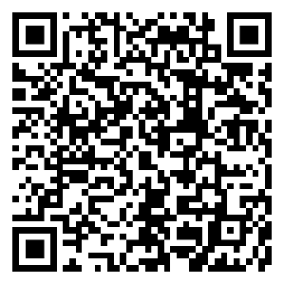
Thank you
Sign up to YEF’s newsletter for latest updates:
www.youthendowmentfund.org.uk/newsletter
hello@youthendowmentfund.org.uk
Notes:
The best way to keep up to date with Toolkit updates including being the first to know about the updates in July is to sign up to our newsletter.
Go to youthendowmentfund.org.uk/newsletter. You’ll also find out about other news from YEF including funding opportunities and other ways to work with us.
And we’d love to hear your feedback on the Toolkit, including new topics you’d like to cover. You can contact us at hello@youthendowmentfund.org.uk
The toolkit is just one of the ways we’re working to give you the information you need to improve support for children in your communities and help ensure that every young life is free from violence in the future.
Thanks for your support. I’m looking forwarding to answering any questions you have about it or YEF’s wider work.

