Slide 1

Another Way Project Update
Ending Youth Violence Network
16 March 2023
Learning from multi-agency delivery projects:
Focused Deterrence Nottingham
Another Way Project
Steve Harrison, Project Manager
steven.harrison1@notts.police.uk
Steve Harrison, Another Way Project Manager
Steven.harrison1@notts.police.uk
Notes:
Everyone loves partnership working, right?
Working in partnership has been at the heart of my career for nearly 30 years.

Slide 2
Agenda
Quick Case Study
Types of Partnership
How to do it better

Slide 3
Straw Poll:
Partnership working is
A waste of everybody’s time
A necessary evil
Worth the effort
Fundamental to good delivery

Slide 4
“By working together, public service organisations can deliver value and outcomes that would be difficult or impossible to deliver working individually.” (LGA)

Slide 5
Lose – Lose | I gain – You Lose
I Lose – You Gain | Win - Win

Slide 6






Slide 7
Case Study
Focused Deterrence Nottingham

Slide 8
Serious Youth Violence
Drugs
County Lines
“Gangs”
Knife Carrying
Anomie
Poverty

Slide 9
Community
Engaging wider community in providing support & encouraging reintegration
Support
Help to access support that individual or community has identified as a need
Deterrence
Clear communication of the consequences of violence and enforcement if violence occurs
Intelligence
Understanding the problem & identifying those at risk

Slide 10
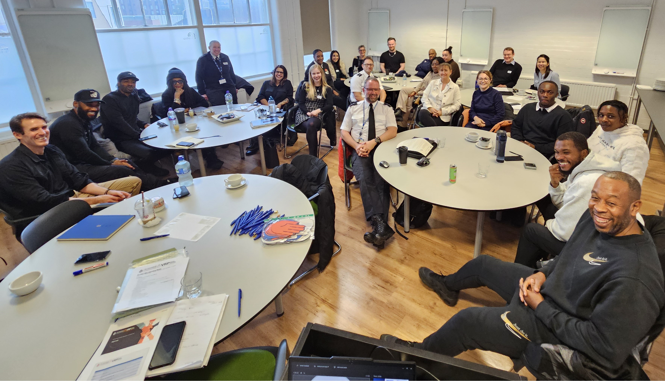
YEF
Home Office
Building Bridges Breaking Barriers (BBBB)
Al Hurraya
City Council
Uni of Hull
Project Team
Analyst
The Children’s Society
Neighbourhood Policing

Slide 11
Partners
Office of Police and Crime Commissioner
Youth Endowment Fund and Home Office and Evaluators
Community
Police
Probation
Council
Community and Voluntary Sector Providers
Notes:
OPCC - Move to closer association with OPCC meant Police email addresses – can be a barrier. Also, pressure for a comms messages.
YEF & HO - Who pays the piper! Jumping through hoops and importantly RCT.
Community – tired of short term initiatives done to them. Harder to promote project when RCT. Challenge of dialogue with right people, need support of families and stakeholders
Police – necessary for support. There is a police view of partnership ☺. For this project support for deterrence essential. Some models use as navigators.
Probation – vision that the YA and Gangs Team led on support for adults - navigators
Council – vision that YJS led on support for children
CVS to bring in additionality to Council Probation offer

Slide 12
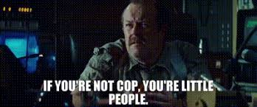

Slide 13
Partnerships
Funding Agreement with YEF
Strategic Violence Reduction Board and Membership
Finance
Information Governance and Data Sharing
Multi-agency delivery group
Community
Enforcement
Support
Evaluation
Notes:
Funding Agreement with YEF
Strategic Violence Reduction Board and Membership –different interests and priorities
Finance - Bid and Finance systems deal with same information v differently
Information Governance and Data Sharing – where do I start!! GDPR but also case management software/double-keying
Multi-agency delivery group – pressure on time, overlap with existing groups and gaps
Community – tread carefully Difficult Conversations Group, respect, micro grants.
Enforcement – neighbourhood policing strong partners but harder to access other resources – Prevention Hub under construction. Tracy an ex cop helped
Support – s151 NCC, Probation capacity leading to procurement
Evaluation – good relationship but continually checking model evolution for compliance.

Slide 14
Partnership isn’t one thing
“Typologies”

Slide 15
Statutory
Voluntary
Project
Informal
Notes:
Public private

Slide 16
Casework
Operational
Tactical
Strategic
Infrastructure
Case Conference
CCE Panel
Safeguarding Board
Shared services

Slide 17
More Vox Pop
What partnership would you consign to oblivion?
What partnership do you really value?
Notes:
My take (may have been covered!)
A. Community Safety Partnerships have had their day – Safeguarding has rightly stepped into space, PCC role overlaps.
B. Focused deterrence in Nottingham – dedicated professionals from VCS, Police etc striving to save children &Yas from harm

Slide 18
Discussion
Blockers
What factors block or damage effective partnership working?
Incentives
What factors can enable and/or sustain partnership working?
Be positive and spend more time on second question!!

Slide 19
Meeting Moans
Too many meetings
Police don’t attend Strat meetings
Health don’t engage
Community reps are negative
The deputies send deputies who ….
The agenda doesn’t go out in advance
Its badly chaired and lasts for ever
One or two people dominate the discussion
No one reads the papers
The notes are rubbish

Slide 20
Incentives?
Organisation
Better understanding - data
Holistic solutions with mutually supporting actions
More legal powers available
Best option selected
Long-term solutions
More resources brought to bear
Enhanced reputation
Me
I can deliver better to my citizens
I can get someone else to pick this one up
I can spread the responsibility
I like working with others
It makes me look good
Evidence for promotion
My citizens really do benefit!!

Slide 21
BUT ALSO
Could I lose/you win create trust/’debt’/obligation?
  Different organisational cultures – collaborate or compete
  Short term risks to my organisation – external metrics
Does it even out over time – other transactions
Multi-lateral not bilateral context
All for the greater good!

Slide 22
