Slide 1



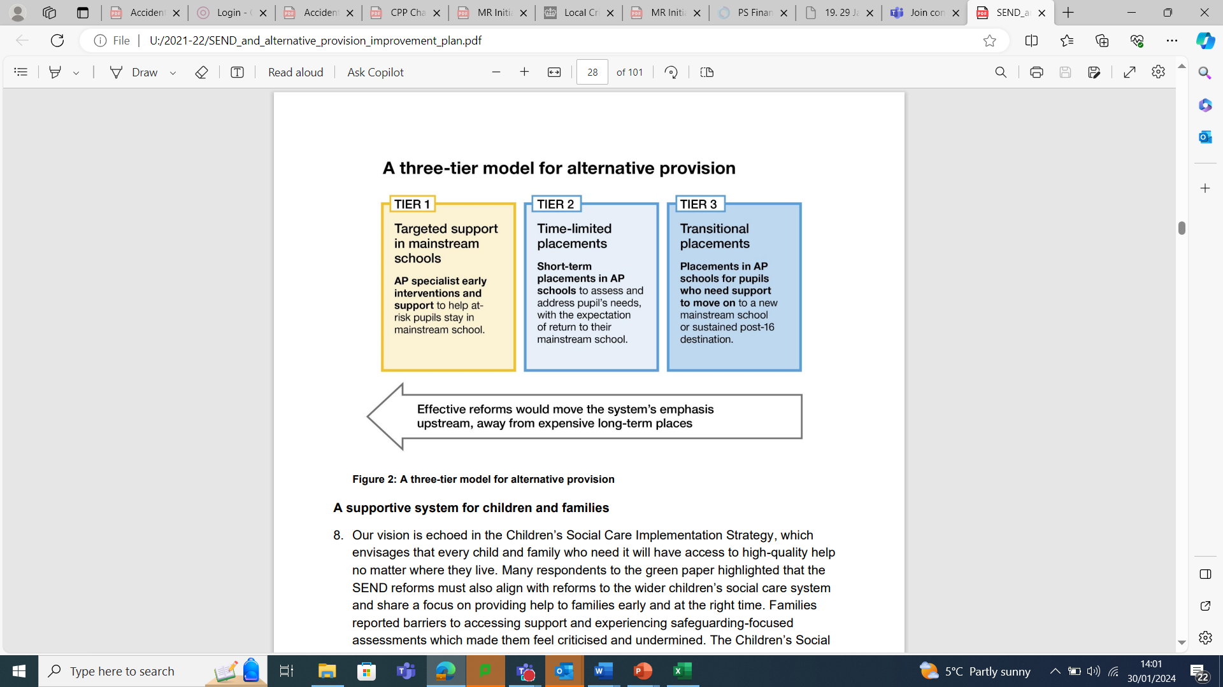
Bradford APST and Safe taskforces
Effective Multi-Agency Working in Alternative Provision & Mainstream School Settings – Learning from Bradford’s SAFE Taskforce and Alternative Provision Specialist Taskforce

Slide 2
Bradford APST and Safe taskforces
Feedback from the YEF to share:
  it’s ok to disagree if we do it respectfully,
  there is no such thing as a silly question,
  these discussions can bring up difficult emotions and encourage people to take care of themselves
  There are different professional backgrounds of people and ask everyone to avoid using jargon or acronyms so that everyone feels included
Content:
Learning from the evolution of BAPA and the APST taskforce
Learning from the Safe taskforce
Use of the Change programme to create a more sustainable model to work with all 3 tiers
Please feel free to ask questions at any point

Slide 3
Bradford APST and Safe taskforces
Stand up Bingo
Please can everyone stand up
Your local authority has sufficient special school places in primary and secondary
Sit down if …
Your higher needs block funding is robust for the foreseeable future
The needs in your local area have fallen post Covid
Your local authority had an APST
Your local authority had a SAFE taskfore
Your local authority is in the Change programme
The retention and recruitment of SENCos in your LA is thriving
You plan to retire in the next 5 years
Your birthday month is between Sept and Dec
You travelled less than 2 hours to get here
You don’t need glasses or contact lenses to read this
You still have a full head of hair

Slide 4

Evolution of Bradford APST through the evaluation project
Initially:
Core Aim – to reduce youth violence
Mental health therapist (0.6)
Speech & language therapist (0.6)
Youth worker (0.8)
Youth Justice Worker (2.8)
Post 16 coach (0.6)
Evolved to:
Mental health therapist (0.6) (+0.2 working in Primary AP)
Speech & language therapist (0.6)
Youth worker (0.8)
Youth Justice Worker (2.8)
Post 16 coach (0.6)
Enrichment Co-Ordinator (0.4) (Non DfE)
Family Support worker (0.4) (Non DfE)
Funded by BAPA
Deployed from school nursing team

Slide 5
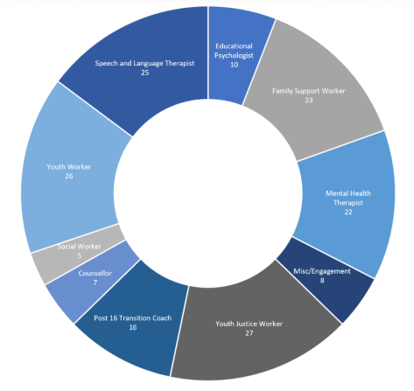
National APSTs
Evolution of the Bradford APST
Evolution of the Bradford APST
Core aim – to reduce youth violence. This has evolved…

Slide 6
Start of Bradford APST
Induction process:
Two days in a hotel
An understanding of BAPA and our vision / intent / culture
Visioning
Non negotiables
How we link together
Referral process
What information was essential / desirable
Trauma informed training provided by an Ed Psych
Impact:
Retention
Change when needed
Minimise disruption to our previous ways of working
Understanding

Slide 7
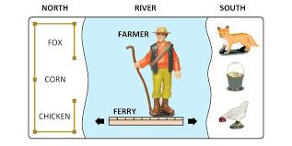
Start of Bradford APST
Learning up to this point:
Relationships were key to increase the likelihood of maintaining and improving our culture
Weekly meeting was CRUCIAL
Our sites were at least one room too small
Co-ordination of “Right support, right place, right time” is a logistical problem to solve, as well as a philosophical one!
All staff need to be kept in the loop regarding the journey

Slide 8
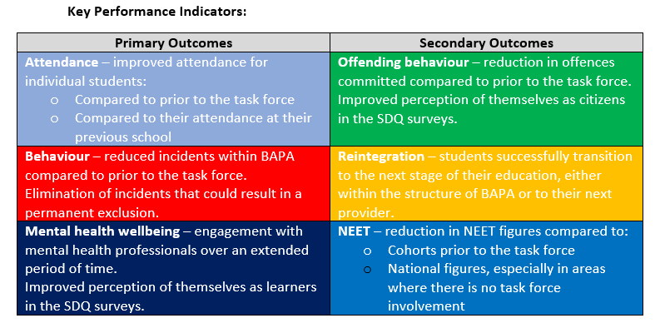
Initial impact of Bradford APST
All indicators were positive from the outset.
(We were building on a solid platform though!!)

Slide 9
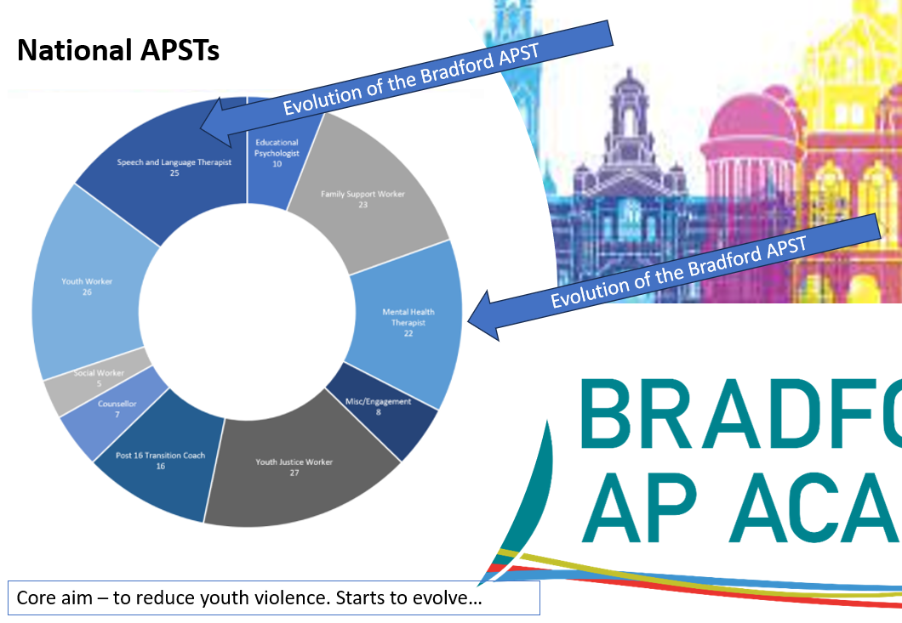
Evolution of Bradford APST
Evolution:
“Getting under the skin of the problem.” Students understanding of themselves
Looking at all the KPIs and beyond
“Right support, at the right place at the right time.”
EHCPs more accurate reflection of need

Slide 10
Evolution of Bradford APST
Morally and financially the best way to work?
Our mental health therapist and SALT became trained in delivering ADOS and ADHD assessments.
Fast tracking of referrals to JAC clinic for the most vulnerable.
Youth workers and YJS workers are incredibly skilled at building positive relationships with hard to reach families.
The co-ordination of support progressed to creating more sustainable end points for student.

Slide 11
Hypothetical case study
Student A:
Permanently excluded in Y9 for taking a bladed article into school.
Previous attendance of 40%
Known to YJS, but not statutory. Lot of ASB and suspected knife carrier in local community.
On SEN register, but SEN support.
Once working with APST:
Stabilised by the AP
SaLT assessment provides diagnosis of DLD, refers to mental health therapist as in need of assessment.
Youth worker supports out of school behaviour. Identifies previously enjoyed football when younger. Links with enrichment co-ordinator to find a local team.
Enrichment co-Ordinator meets, provides new kit, supports football coach with training on students needs
Fast tracked through neuro assessment, then follow up.
EHCA via JAM – 10 weeks.
Family support worker, provides parental support

Slide 12
Task
Can you match the answer to the question?
Answers:
3
33
25
26,000
86
271,000
140
20
10
16,000
14
6
3
35
3

Slide 13
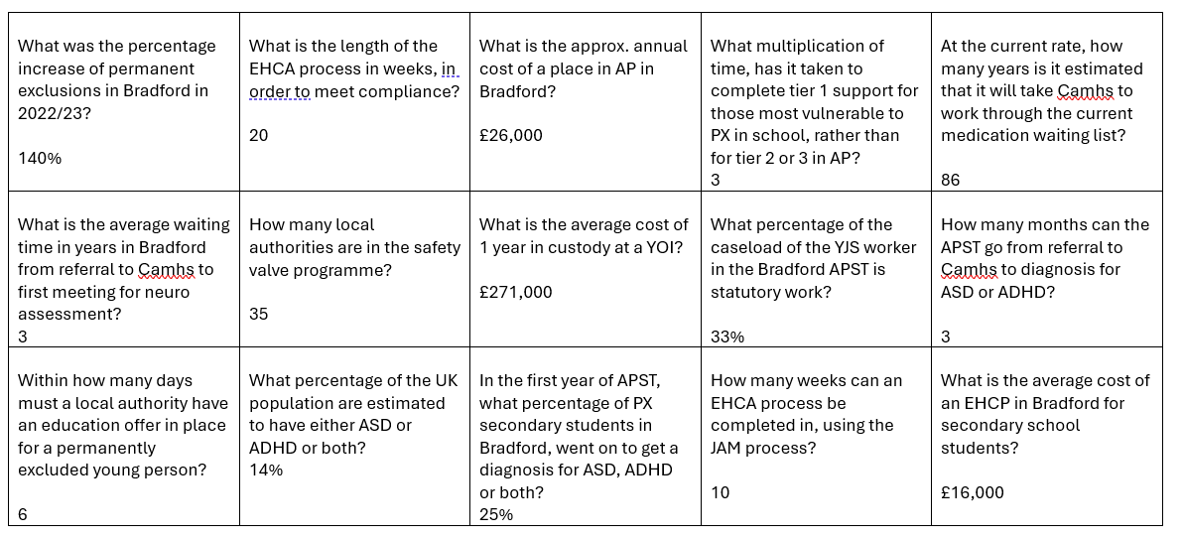

Slide 14
Task
Discussion:
What do you think are the moral and financial debates that have taken place regarding the setting up of an extended and sustainable taskforce in Bradford?

Slide 15


What is the SAFE Taskforce?
2021 Beating Crime Plan
£30 million for 10 SAFE Taskforce areas – DfE funding
Bradford allocated £3.37 million over three years
Commission and invest in evidence-informed interventions that:
  Tackle violence directly
  Increase engagement in education
  Improve behaviour and attendance
Support young people with challenging behaviour
Attend school regularly
Fulfil their potential
Exceed their expectations
18 secondary schools identified to join the Taskforce

Slide 16
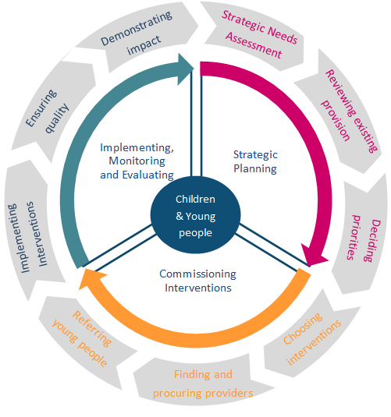

Commissioning
Consultation
Strategic Needs Analysis
School Needs Survey
Community Voice – 431 responses
Student Voice – 1729 responses
Secondary data – VRP publications
Stakeholder engagement
Steering group
Safer Schools Policing team
Community Safety
Local Authority Attendance Team
Education sub-group

Slide 17
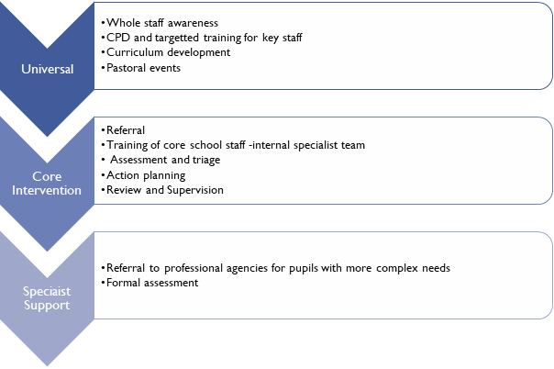
Priority Needs – Identified through strategic needs assessment & consultation
Need 1 - Social and Emotional Regulation
Need 2 - Anti Social Behaviour
Need 3 - Developmental Delay in Social Language
Need 4 - Mental Health
Need 5 - Attendance
Need 6 - Girl's involvement in serious violence

Slide 18


At a glance overview
18 secondary schools
42 staff members
44 primary schools
1304 individual children supported
8 interventions
Over 20,000 children reached through SAFE activities

Slide 19
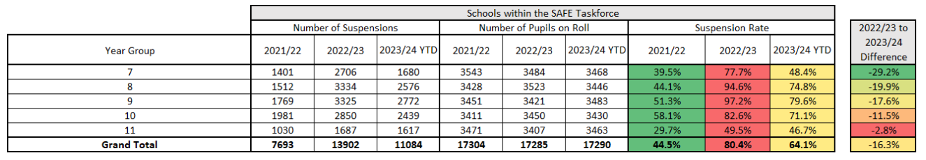
Early Impact Analysis – Suspensions & Attendance
Reduction in suspensions for Taskforce schools 22/23 to 23/24 in Y7-9 is -22.2%
Suspension for physical assault against a pupil has seen a reduction in the number of days lost to suspension in 2023 when compared to 2022 = indicating less suspensions/shorter exclusions
Suspension for physical assault against a pupil has also seen a reduction in the proportion of days lost
  In 2021 approximately 20% of all days lost
  In 2023 approximately 10% of all days lost to date
Attendance:
An average of 43% of the SAFE cohort recorded improved half-termly attendance at school
An average of 45% of the SAFE cohort recorded improved termly attendance
YJS known SAFE Cohort:
24% of participants demonstrated improved attendance across the comparative term blocks

Slide 20




Funded Interventions 7 interventions over 3 years
Character education curriculum delivered by trained instructors
Resilience, empathy, self-awareness, passion, excellence, communication and teamwork
Small groups and one-to-one work
Support for girls at risk of violence as both victims and perpetrators
Lived experience model
Mentoring and group work alongside year group assemblies
Attendance-focused project focusing on persistently absent cohort
Work outside of school with the whole family to remove barriers to attendance
‘Whatever it Takes’
YES Project
Mentoring and social skills development
Managing Anger, Behind the Blade & bespoke offerings

Slide 21



Funded Interventions
Educational Psychology – purchased 150 sessions per year
Identification of needs at an earlier stage
Support with transition & development of EHCP’s
BD4 Attendance Pilot – three schools in the catchment
Assertive outreach programme, targeting 70-85% persistently absent children
CCE prevention
After-school activities fund
To provide activities and supervision in the 3pm-5pm window
Enrichment, sports and arts focused
*All interventions based on a bespoke Strategic Needs Analysis, alongside surveys of schools, pupils and the wider community. VRP Needs Analysis also used in development

Slide 22

Children carrying a knife in school
A significant reduction in recorded incidents of children carrying a bladed article on school premises:
2022 – 44 incidents
2023 – 17 incidents (representing a 62% reduction from the previous year)
2024 to date – 6 incidents

Slide 23

As we approached 31 March 2025!!
Aim was for an extended and sustainable Bradford taskforce
The Change Programme was our main way of engineering these conversations.
A joint APST and Safe taskforce becomes a Bradford Taskforce
Youth workers supporting those who are not quite vulnerable to PX, but potentially escalating. Can refer to APST:
APST work 60/40 split with those in all three tiers, using taskforce model

Slide 24
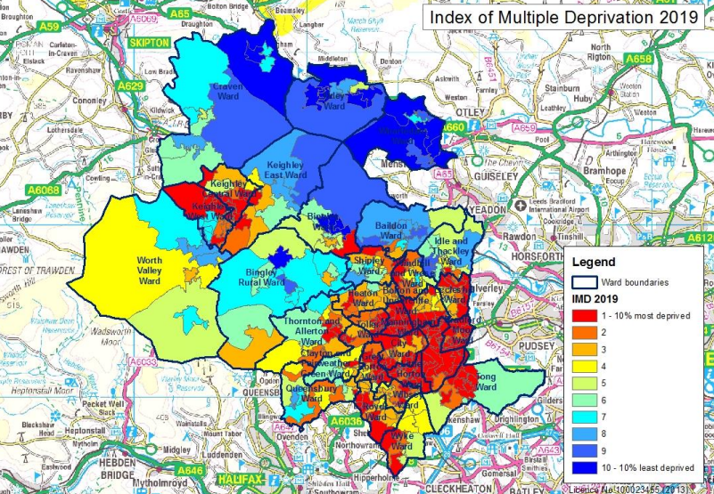
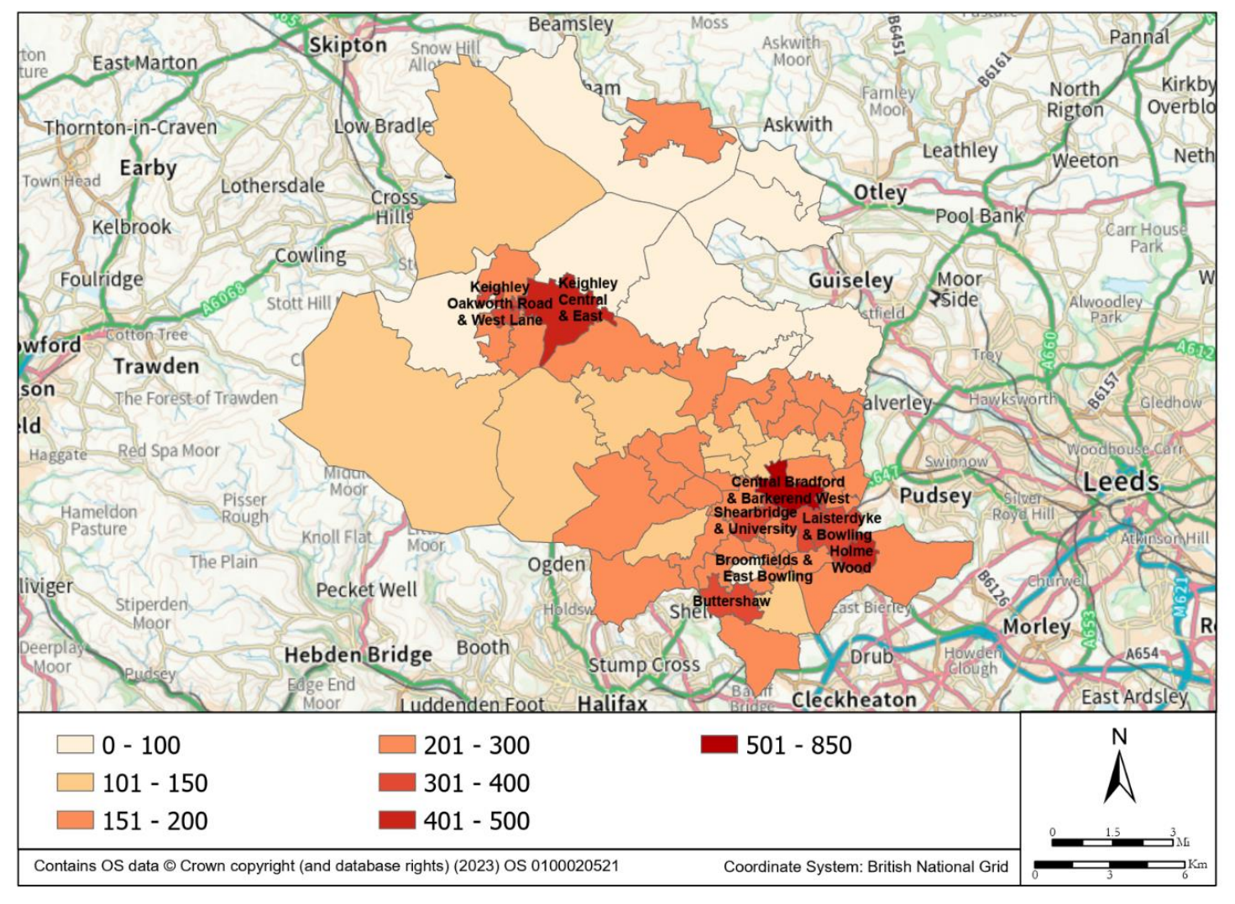
Bradford Context
Bradford falls within the national top 10% most deprived local authorities in England
High levels of inequality
4th highest proportion of children under the age of 15 (21.4%)
Highly diverse population
A Trust is in place to run Children’s Services.
LA Ofsted SEND report cites significant areas of weakness
Attendance is very low compared to national averages
Significant number of secondary schools are currently rated as RI or below
Last year permanent exclusions rose by 140%
Significant concerns over the city’s finances

Slide 25
Local Authority AP strategy:
Increased AP and Specialist provision (BAPA growing from 75 to 140 students)
LA to provide list of AP available in the city and to support in quality assuring this
Review of FAP and SEN processes
Taskforce to support those vulnerable to permanent exclusion

Slide 26
Where we are up to:
Role | Funding 25/26 | Funding beyond 25/26
Leader (0.2) | DfE | HNB
Co-Ordinator (0.6) | DfE | HNB
Mental health therapist (1.0) | Change prog | Change prog (?)
SaLTs (2.5) | Deployed | Deployed
YJS (1.6) | Deployed | Deployed
Youth workers (1.6) | Deployed | Deployed
Youth worker apprentice (1.0) | DfE | HNB
Family support worker (1.0) | DfE | TBC
Youth workers (approx. 3) | LA | LA
Post 16 coach (1.2) | HNB | HNB
Enrichment Co-Ordinator | HNB | HNB
St Giles trust | Deployed | Deployed
£360k annually from the HNB funding
Approx £420k of resources deployed in
40% 60%

Slide 27
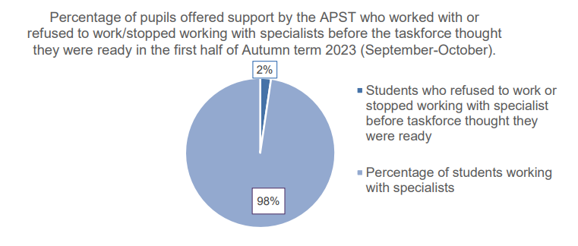
Key indicator from APSTs overall

