Slide 1

Tackling Child Exploitation: taking a principled approach
Dez Holmes
Director, Research in Practice
@dez_holmes

Slide 2

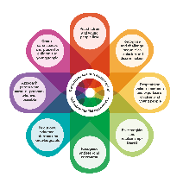
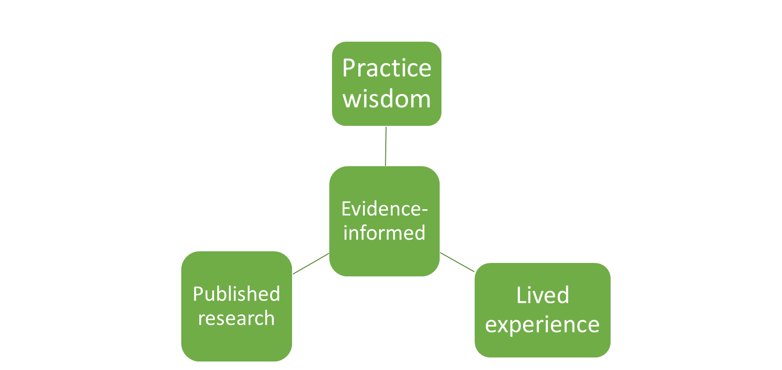
Background
TCE Programme: a DfE-funded consortium programme led by Research in Practice with The Children’s Society and the Safer Young Lives Centre at the University of Bedfordshire.
2019-22, TCE supported over 80 areas across England to improve their strategic responses to child exploitation and extra-familial harm.
2022-23, TCE was commissioned to develop a set of Practice Principles to inform local multi-agency responses to child exploitation and extra-familial harm.
​
Over 750 multi-agency professionals across England​​
200 children and young people​
39 parents and carers

Slide 3
The Practice Principles
Interrelated and interdependent, focusing on the 'how' not the 'what’.
Offer a compass to help navigate a complex landscape, rather than a detailed map for every individual situation.
Are high-level to support a coherent approach across local partnerships and to support multi agency working.
Focus on behaviours and culture to help direct work with children, young people, and families, operational management and strategic leadership to align.
Aim to complement existing and forthcoming guidance endure over time and fit with diverse local contexts

Slide 4
Practice
Management
Strategic leadership and partnership
Parallel processes
Whole system change
Congruence and coherence
Modelling

Slide 5
The eight Practice Principles
The Practice Principles
Initial reactions…?

Slide 6
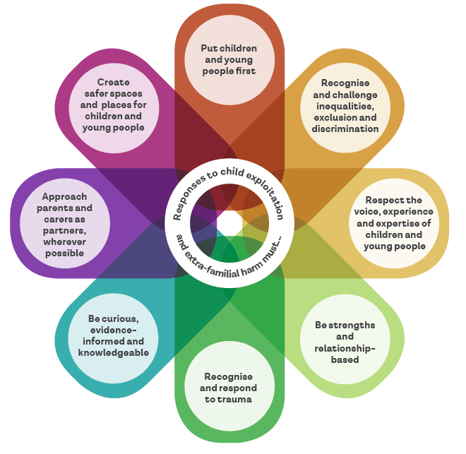
The eight Practice Principles
The Practice Principles

Slide 7

  Practice Principle 1
Responses to child exploitation and
extra-familial harm must…
Put children and young
people first

Slide 8
Put children and young
people first
Children cannot be held responsible for harm caused by others
Where children are causing harm – they are still children & responses should reflect that
All children and young people deserve to be supported in a way that respects their rights and offers protection
The complexities and presentation of child exploitation and extra-familial harm means that responses sometimes undermine the realisation of these rights

Slide 9
Put children and young
people first
How it should feel for a child / young person being supported:
“I feel understood, believed and treated like a human being. I feel my worker is interested in me and on my side. I know they don’t judge or blame me.”

Slide 10

  Practice Principle 2
Responses to child exploitation and extra-familial harm must…
Recognise and challenge inequalities, exclusion and discrimination

Slide 11
Recognise and challenge inequalities,
exclusion and discrimination
Inequalities, exclusion and discrimination faced by children, young people and their parents / carers can be experienced in multiple ways and must be recognised and challenged
Systems issues can affect outcomes for children and young people, e.g. what data are or are not collected
Importance of developing an inclusive culture

Slide 12
Recognise and challenge inequalities,
exclusion and discrimination
How it should feel for a child / young person being supported:
“I am seen, respected and accepted for who I am, professionals can relate to me, and they challenge any discrimination I face.”

Slide 13

  Practice Principle 3
Children and young people:
  have the right to have a say about matters that affect them and be heard in decisions made about them
  should be respected and listened to as experts in their own lives: to develop trusting relationships and increase safety
Participation is a powerful way to invert the coercion and manipulation of exploitation and extra-familial harm
How it should feel for a child / young person being supported
I feel heard, acknowledged, and validated because my views and opinions are sought and included. This matters to me and makes me want to talk to them.
Responses to child exploitation and
extra-familial harm must…
Respect the voices, experiences and expertise of children and young people

Slide 14
Respect the voices, experience and
expertise of children and young people
Children and young people:
  have the right to have a say about matters that affect them and be heard in decisions made about them
  should be respected and listened to as experts in their own lives: to develop trusting relationships and increase safety
Participation is a powerful way to invert the coercion and manipulation of exploitation and extra-familial harm
How it should feel for a child / young person being supported
I feel heard, acknowledged, and validated because my views and opinions are sought and included. This matters to me and makes me want to talk to them.
Children and young people:
  have the right to have a say about matters that affect them and be heard in decisions made about them
  should be respected and listened to as experts in their own lives: to develop trusting relationships and increase safety
  Participation is a powerful way to invert the coercion and manipulation of exploitation and extra-familial harm

Slide 15
Respect the voices, experience and
expertise of children and young people
How it should feel for a child / young person being supported:
“I feel heard, acknowledged, and validated because my views and opinions are sought and included. This matters to me and makes me want to talk to them.”

Slide 16

.
  Practice Principle 4
Responses to child exploitation and
extra-familial harm must…
Be strengths-based and relationship-based

Slide 17
.
Be strengths-based
and relationships based
Applies to working with children, young people, parents, carers and colleagues
Take a holistic approach: identify strengths, positive factors
Build on strengths, assets; work relationally to support growth and change

Slide 18
Be strengths-based
and relationships based
How it should feel for a child / young person being supported:
“I have someone to go to who genuinely cares about me and my future. They do things to actually help me. I feel safe with them and can trust them.”

Slide 19

  Practice Principle 5
Responses to child exploitation and
extra-familial harm must…
Recognise and respond to trauma

Slide 20
Recognise and respond to trauma
Understand how individuals perceive and respond to threats and support.
Recognise that these responses might underpin perceived ‘non-engagement’ or ‘negative’ coping strategies.
Trauma can be experienced at different levels:
  Direct trauma for children and young people - and potentially their parents / carers
  Trauma that can impact wider communities, stemming from shared experiences
  Trauma that can impact those working to support and protect traumatised individuals

Slide 21
Recognise and respond to trauma
How it should feel for a child / young person being supported:
“People understand how I have been affected by what has happened to me and they show that in the way they help me. I feel like I matter.”

Slide 22

PP6: Responses to child exploitation and extra-familial harm must be curious, evidence-informed and knowledgeable
.
  Practice Principle 6
Responses to child exploitation and
extra-familial harm must…
Be curious, evidence-informed and knowledgeable

Slide 23
PP6: Responses to child exploitation and extra-familial harm must be curious, evidence-informed and knowledgeable
.
Be curious, evidence-informed
and knowledgeable
Responding to the complexity of child exploitation and extra-familial harm requires:
  curiosity, critical thinking, analysis skills
  thoughtful use of evidence
  a commitment to reflection and learning
Balance pace with purpose

Slide 24
Be curious, evidence-informed
and knowledgeable
How it should feel for a child / young person being supported:
“I feel properly seen, because the people who are there to help me put in the effort to understand me and my life. They are knowledgeable, and are always learning about how to help me feel safer.”

Slide 25

PP7: Responses to child exploitation and extra-familial harm must approach parents and carers as partners wherever possible
.
  Practice Principle 7
Responses to child exploitation and
extra-familial harm must…
Approach parents and carers as partners wherever possible

Slide 26
PP7: Responses to child exploitation and extra-familial harm must approach parents and carers as partners wherever possible
.
Approach parents and carers as partners wherever possible
Starting point: include parents and carers as partners
Parents and carers can hold invaluable information about their child and the contexts of their lives
Acknowledge and attend to their own potential distress
Recognition that circumstances will differ between families so there is no ‘one size fits all’ solution.

Slide 27
Approach parents and carers as partners wherever possible
How it should feel for a child / young person being supported:
“I am included in decisions about involving my parents and carers. Supporting my parents and / or carers to understand what has happened to me can help improve family relationships and the support I receive.”

Slide 28

.
.
  Practice Principle 8
Responses to child exploitation and
extra-familial harm must…
Create safe spaces and places for children and young people

Slide 29
.
.
Create safe spaces and places for children and young people
Understanding of harms and protective factors in spaces and places where children and young people spend their time (on- and off-line)
Identify harm and intervene accordingly (e.g. disruption) to make the space/place safer
This focus can prevent children and young people feeling blamed

Slide 30
Create safe spaces and places for children and young people
How it should feel for a child / young person being supported:
“In my community, I have opportunities to do activities and make new friends. The spaces and places where I spend my time feel safe, and give me a sense of belonging.”

Slide 31
.
Which Principles resonate most with your practice / leadership, at its best?
Which ones offer the greatest challenge to you?
How might you use them to support improvement and development in your local system?

Slide 32
Supporting Resources
Six supporting resources to support the application of the Practice Principles:
An evidence summary, a succinct summary of the research drawn upon in developing the Principles
An individual practice and reflection tool, a professional development tool to support practitioners to reflect on the Principles, and their application to their own practice
A multi-agency partnership reflective tool, an interactive, reflective tool for local partnerships to work together to assess their responses to child exploitation and extra-familial harm
An animation to explain the evidence, ideas and interdependencies that underpin the Principles
Parent and Carers Shifting Mindset, a resource to support local agencies and partnerships to engage parents and carers as partners at an operational and strategic level
Youth Voice in strategic change, a resource to help local agency leaders and partnerships incorporate children and young people’s views at a strategic level.

