Slide 1

Race Equity in Children’s Services & Multi-Agency Partnerships
Antonia Ogundayisi
Race Equity Associate – Children Services Sector

Slide 2

Warming the Context for Racial Dialogue
‘Warm’ topics / ideas have greater chance of enduring (Bateson, 1972) .
How does talking about Race make you feel - warm or cold?
Do you move close or move away?
Why / why not?
Notes:
Bateson (1972) talks of ‘warm ideas’ as having a greater chance of survival than ‘cold ideas’

Slide 3
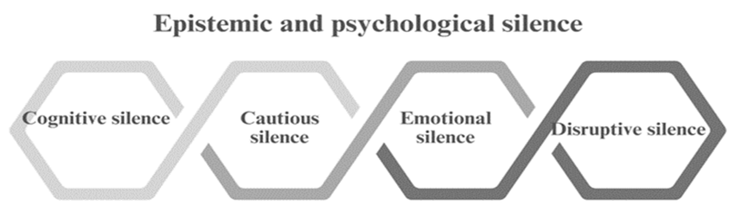

Talking about Race
Company Morales, Miguel & Casadó-Marín, Lina & Muñoz Garcia, Araceli & Fontalba Navas, Andres. (2024).

Slide 4


Breaking (through) the silence

Slide 5
TAME
CRITICAL
WICKED

Slide 6
UK Legal landscape: Race Equity & Children Protection
Race Relations Act 1965, 1968, 1976, 2000
Macpherson Report (1999)
Equality Act 2010
Independent review of Children’s Social Care (2021)
Child Safeguarding Practice Review (Race, Racism) 2025
Children’s Act (1989)
The Victoria Climbie Inquiry (2003)
Commission on Race and Ethnic Disparities Report (2021)
Casey Review (2023)

Slide 7

The Practice Landscape
Black children are 6x more likely to be murdered in the UK
(YEF, 2025)
Exclusion rates for Black Caribbean students are 6x higher than those of their peers
(The Guardian, 2021)
Police are more than 6x likely to strip-search black children (The Guardian, 2024)
Only 6% of Directors of Social Care are Black
(Community Care, 2022)
Black children wait longer to be adopted than white children
(Ending Racial Disparity in Adoption Report, 2022)
Black babies are 3x more likely to die than white babies
(ONS, 2022)

Slide 8

Black children are 6x more likely to be murdered in the UK
(YEF, 2025)
Exclusion rates for Black Caribbean students are 6x higher than those of their peers
(The Guardian, 2021)
Police are more than 6x likely to strip-search black children (The Guardian, 2024)
Black babies are 3x more likely to die than white babies
(ONS, 2022)
Only 6% of Directors of Social Care are Black
(Community Care, 2022)
Black children wait longer to be adopted than white children
(Ending Racial Disparity in Adoption Report, 2022)
SYSTEMIC RACISM
Kendi (2020) defines racism as: "Racism is a marriage of racist policies and racist ideas that produces and normalises racial inequities."

Slide 9


SERIOUS YOUTH VIOLENCE
Black children are 6x more likely to be murdered in the UK
EDUCATION
Exclusion rates for Black Caribbean students are 6x higher than those of their peers
POLICE
Police are more than 6x likely to strip-search black children
HEALTH
Black babies are 3x more likely to die than white babies
SOCIAL CARE
Only 6% of Directors of Social Care are Black
SOCIAL CARE
Black children wait longer to be adopted than white children
WHITE-CENTERING POLICIES, PRACTICES, PROCEDURES, POWER DYNAMICS
(SYSTEMIC RACISM)

Slide 10

Do you water or axe?
If we followed you around the office /personal life everyday for 12 months, what would we see?

Slide 11
SERIOUS YOUTH VIOLENCE
Black children are 6x more likely to be murdered in the UK
EDUCATION
Exclusion rates for Black Caribbean students are 6x higher than those of their peers
POLICE
Police are more than 6x likely to strip-search black children
HEALTH
Black babies are 3x more likely to die than white babies
SOCIAL CARE
Only 6% of Directors of Social Care are Black
SOCIAL CARE
Black children wait longer to be adopted than white children
EVERY CHILD REALLY MATTERS

Slide 12
Being an anti-racist leader
“Anti-racist leadership is understanding your how your racial and social identities intersect with power and privilege. It is about being intentional in crafting your organisational culture and environment, and supporting people through equitable organisational structures.”
(Dr. Nicole Evans, Embracing Equity)
Would you be described as an anti-racist leader?

Slide 13
Anti-Racist Systems Leadership:
It’s a mindset
Being ethics-driven –
A moral imperative
Frequent conscious internal introspection
Amplifying marginalised (Black) voices without exploiting emotional labour
Accountability / affinity circles
Humility
Integrity and Authenticity
Tolerate uncertainty and discomfort
Not about saviour-ship or heroism – it is about doing the right thing

Slide 14
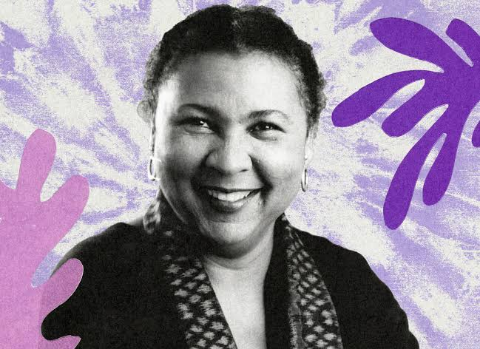
Move beyond individualism – build community, not just partnerships
“To build community requires vigilant awareness of the work we must continually do to undermine all the socialization that leads us to behave in ways that perpetuate domination.”
- Bell Hooks,
Writer, Theorist, Educator and Social Critic

Slide 15
Build community at a systems level
Racism remains a deeply intricate and ever-changing challenge, even in the face of ongoing efforts to address it. (Spillett, M. (2024)
Financial constraints and racial inequities create a multifaceted issue that demands thoughtful and strategic solutions.
Tackling racism requires collective action and collaboration, drawing on the expertise and perspectives of others.
It is essential to uplift and center the voices of Black leaders—particularly Black women—who bring a crucial intersectional perspective.
A single-service approach is insufficient in addressing the complexities of racism. Instead, a coordinated, multi-agency strategy is necessary (Ghate, Lewis & Welbourn, 2013).
The focus should not be on rigid control but on fostering influence, ethical leadership, and a commitment to doing what is right.

Slide 16
Leading effective multi-agency partnerships:
A Call to Action
Critically examine your own racial identity
Set a clear organisational anti-racist vision
Build anti-racist relational networks

Slide 17




Stay in touch
Antonia Ogundayisi
anthonia10@hotmail.com
@AntoniaOgun

