Slide 1
What are we learning about multi-agency working from recent innovations
Prof Carlene Firmin, Durham University

Slide 2
Explore the answer to the question using two studies
Innovate Project: Four Year Ethnographic study across six sites funded by the ESRC
Planning for Safety Project: Three phase pilot of alternative child protection pathways funded by the DfE

Slide 3
Three points of learning
Care-orientated partnerships
Action-orientated partnerships
Parent and professional partnerships

Slide 4
Care-orientated partnerships

Slide 5
We are seeking to safeguard young people from harm using a system that they had been designed out of…..
[intended to separate out] delinquent or naughty children – those who were out of control, falling into bad associations or in moral danger – rather than proceedings in respect of children who were suffering or at risk of suffering neglect or abuse (Hale 2019:2)

Slide 6
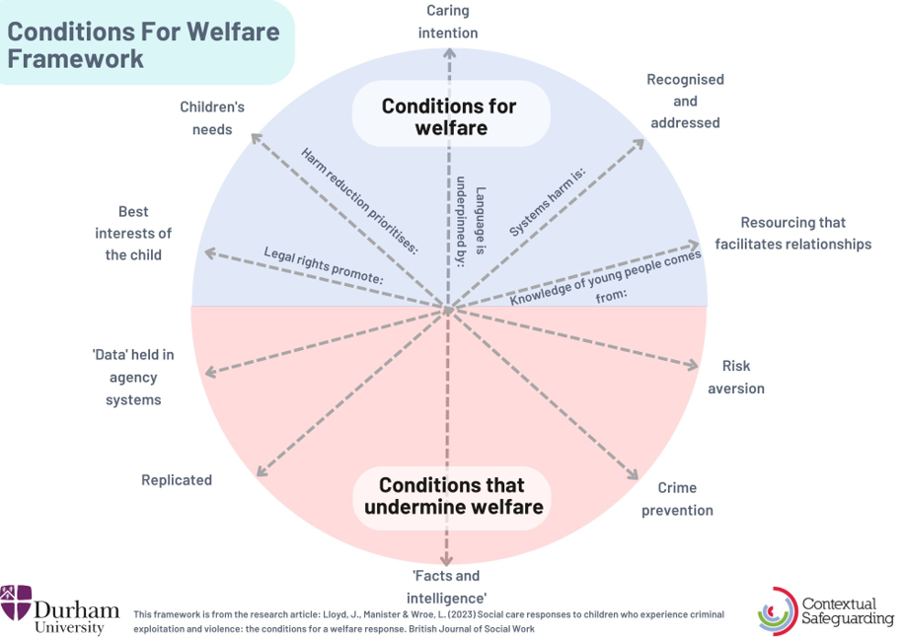
My young man that’s missing currently, the police think they may know where he is, but they’re not willing to disclose that information to anyone because they want to shut down the county line that he’s operating within. And they have said that when they find him, they will most likely arrest him. He’s fourteen… The police have one angle, social care have an angle… (Innovate Project, Transitional Safeguarding Learning Group)
Notes:
–– information about yourselves and the contexts you are responsible for
Power: Agencies a potential source of harm as well as a source of protection

Slide 7


Foundation of Care
Caring Responses
Centre relationships
Humanise those involved
Recognise contexts in which safety is sought
We have two main things to work on still - finding more ways to offer ‘Laura’ and her friends fun, exciting opportunities to spend time together so they feel less need to go missing and getting the necessary school support in place so that Laura can feel safe and comfortable to be in school every day. (Planning for Safety, ROTH Social Work Assessment, Document 3, Site 1)
Chair – tell us what type of person XXX is
Grandad – He was a lovely kid (Grandad getting emotional) he’s just got mixed up with wrong crowd, don’t want to give it as an excuse, can’t defend it, but don’t know if it’s him or them…
Social worker – he loved to draw didn’t he
Grandad – he loved running, was so good at it, but stopped doing it ((Planning for Safety, Observation 05, Researcher Notes)
Notes:
caring responses centre relationships; relationships are both a source of knowledge about extra-familial harm and a response to extra-familial harm
caring responses humanise all those involved
care is demonstrated by recognising the contexts in which people are trying to create safety, as well as the contexts in which harm occurs

Slide 8
Procedural features of partnership working that struggle to facilitate this….
Panel practices
Risk ratings and scores
Referral framed as a response
Unclear dominant culture / outcome mechanism
Elsewhere, we saw little-to-no interagency disagreement, and in the process, a loss of social care identity, such as a police officer being considered a sufficient replacement for a social worker to provide a young person with a consistent relationship (Vignette 1), or hearing social workers use the term ‘intel’ to describe information gathered for their assessments (three sites).

Slide 9
Can lead to social care blurring with policing
YP1 has been stop checked with YP2. YP1 does not talk about his peers/associates. YP1 has links to YP4, as they were arrested for Burglary offence together. YP1 is also linked to YP8 and they are close friends at present. […] Professionals have not been able to engage with YP6 and YP3 and their peers and associates. (Peer assessment)
They are all talented with many positive core values and a capacity for kindness and, to use one of their favourite words, love. It is my opinion that they all have the potential for successful life outcomes if they can receive and make use of the best possible support. (Peer assessment)

Slide 10
Action orientated meetings

Slide 11
Difference between tone and action
Welfare-orientated tone increasingly evident
Justice-orientated actions often still the result
Chair opens the conference: This type of conference is also about learning, and remembering the appropriateness of the language that we use, very important that they are framed as a child and kindly…(Observation O9, Researcher Notes)
They reported that ‘relationships have not been great with local kids’, and they were now ‘trying [to] get to know the kids’. When a panelist asked if anyone was doing ‘group mapping’, the police offered to take this forward.

Slide 12
Difference between information sharing and sharing actions
Evidence of over-sharing in both projects
Actions often not taken on information that is held
Meetings contain anxiety but do not necessarily facilitate action
What is it people are seeking to do?
‘… So what is our safeguarding responsibility to this person?…[our] greatest tool is about a way of being in relationship with young people…[but] we go into those meetings and nobody really knows how to fix it. We’re kind of sitting there and going, ‘these things feel beyond our grasp’, and that feels quite self-defeating’. (Interview, Site 4)

Slide 13
Effort vs. Change
Multi-agency panels can generate a lot of effort:
Referrals
Information sharing
Mapping
Further meetings
But is it not clear that all of this effort results in change for the young person

Slide 14
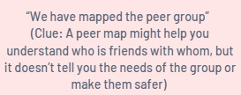
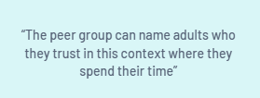
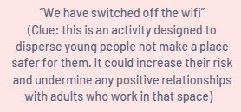

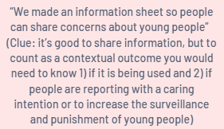
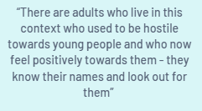
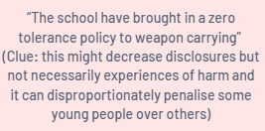

Measuring effort or measuring change?

Slide 15

Identified need / vulnerability / risk
Goal in relation to the need / vulnerability / risk
Actions that realise that goal / meet that need
Planning that meets individual needs
YP rarely has time with peers when they are safe
Safe time with their peers
Coordinated parents’ group / time doing X activity
Planning for Safety

Slide 16
Need / guardianship / environmental factor
Goal in relation to the need / guardianship / environmental factor
Actions that realise that goal / meet that need
Planning that responds to contexts
Safe adults needed at college / bus terminus / high street
Increased ‘guardianship’ at college / bus terminus
Business surveys
Training
Mapping with YP etc
Planning for Safety

Slide 17
Partnership with parents/carers

Slide 18
Parents/carers participate in safeguarding processes in certain conditions
Conference preparation and structure
Share their priority concerns
Share contextual and system harms/risks
Outline what was/had been working well
Identify what was needed to increase safety
CARE
Chair: [it’s] very difficult to disrupt what’s happening. In the meantime, you are having to hold that risk as a family…
Mum: … We ground him and the second he’s not grounded he’s out doing the same stuff. (Mum seems really defeated)
Chair: make sure she has out of hours number, you need to ensure you have emotional support as this is really difficult (Observation 04, Researcher Notes)

Slide 19
But be alert to complexities
she's still my baby. And she will always be. And it's just, I think a little bit more understanding for those that aren't parents of how much, you know, how much that sort of stuff hurts and how much it affects you, how long it takes you to get over listening to all of that stuff (Parent interview, I25)
Impact on familial relationships
Partners not professionals
How might a young person experience their parent/carer collaborating with professionals?
Overlap with familial harm
How to be attentive to the fact that parents are partners but not professionals
Maintain engagement
How do you recognise and respond to emergent challenges withing the family?
How to maintain engagement when risks continue to escalate or take time to recede?

Slide 20
Where we are at reflects three stages of development
Stage 1: System implementation is at fault
Stage 2: System design is at fault
Stage 3: System foundation is at fault

Slide 21

Four shortcomings in system purpose (Firmin et al 2024)
Individualistic approaches to service design and delivery
Prioritising risk mitigation over creating safety and flourishing
Prioritising criminal justice interests over children’s interests
Institutional and structural discrimination remains unaddressed

Slide 22

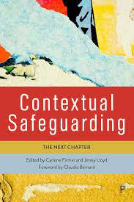
Stay in touch
@carlenefirmin – BlueSky
@profcarlenefirmin - IG carlene.e.firmin@durham.ac.uk www.contextualsafeguarding.org.uk

