Slide 1
Adverse and positive childhood experiences and their associations with children’s involvement in violence: analyses of data from the Millennium Cohort Study
Centre for longitudinal studies, social research institute
Dr Aase Villadsen, Dr Nicolás Libuy, Professor Emla Fitzsimons
Funder: Youth Endowment Fund
Presentation to YEF on 17 January 2025

Slide 2
BACKGROUND

Slide 3
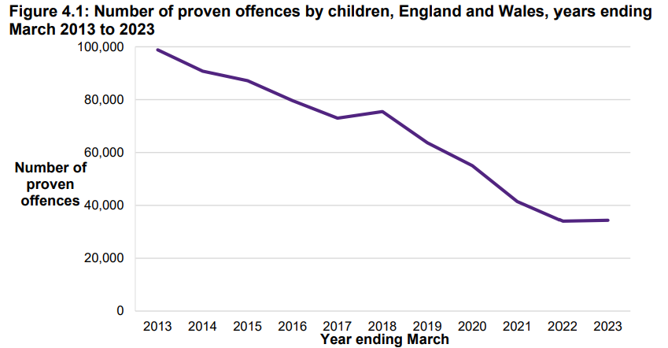

Youth offending has declined over the last decade in England and Wales.
Source: Youth Justice Board, 2024

Slide 4
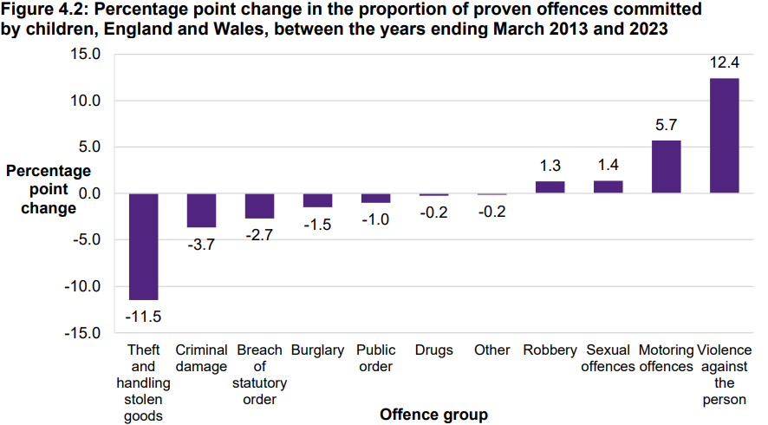
However, violent offences among youth remain high
Source: Youth Justice Board, 2024

Slide 5
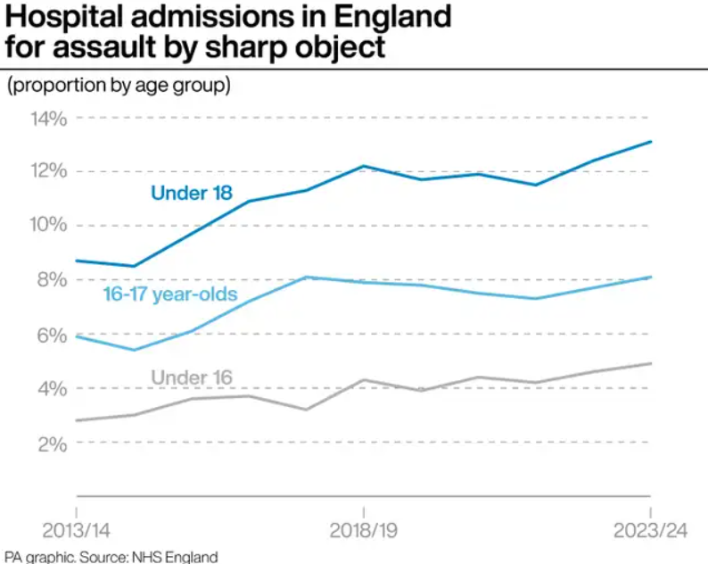
Knife and weapon offences have risen significantly amongst young people

Slide 6
Aims of study
  This study examines how experiences and environments in childhood is associated with violence in adolescence:
          Adverse childhood experiences (ACEs)
          Positive childhood experiences (PCEs)
          Neighbourhood violent crime

Slide 7
Adverse childhood experiences (ACEs)
Framework by Felitti et al. (1998) identifies 10 ACEs.
Includes abuse, neglect, family substance misuse, parental incarceration, parental separation.
Focus on the accumulation of multiple family dysfunctions rather than single factors
ACEs impact stress responses, brain development, and behavioural patterns.
‘Toxic stress’ can lead to chronic maladaptive behaviour (Shonkoff et al., 2012).
Research shows ACEs detrimental to various outcomes later in life (health, mental health, employment, crime etc)

Slide 8
Positive childhood experiences (PCEs)
PCEs support resilience against negative outcomes (Bethell et al., 2019).
Mechanisms like ACEs, but does the opposite by promoting development of competencies, self-regulation and social skills.
PCEs less well developed compared to ACEs. Generally includes supportive family, peer support, school engagement, and community participation.
Research links PCEs to enhanced outcomes (physical health, mental health, academic success, reduced offending).
May buffer the negative effects of ACEs. Shown in previous studies, including offending (Craig et al., 2017),

Slide 9
Neighbourhood violence
Effects of neighbourhood on individual’s behaviour
Theories suggest mechanisms like social networks, economic conditions, and community resources (Wilson, 1987).
Exposure to or witnessing violent crime can increase likelihood of youth violence (Centre for Crime and Justice Studies, 2009).
Many dimensions of the neighbourhood, violent crime is just one
Selection bias makes causal inference challenging (Van Ham et al., 2011).
          Neighbourhood characteristics highly correlated with individual and family characteristics, which may be main drivers of youth violence
Notes:
understanding the causal role of the neighbourhood is immensely challenging, as neighbourhood characteristics tend to be highly correlated with individual and family characteristics, including ACEs and PCEs (i.e. selection bias; Van Ham et al., 2011), which may be the main causal drivers of outcomes such as youth violence.

Slide 10
Research gaps & importance
UK-based research is limited, most studies are from the US
Reliance on retrospective cross-sectional data, lack of prospective longitudinal data
Buffering of PCEs against ACEs is especially under-researched.
Understanding differences by gender and ethnicity.
Identifying predictors of youth violence highly important for policy, practice, and intervention.
Relevant to Government’s ambition of halving knife crime within a decade.

Slide 11
Research questions
How do ACEs and PCEs relate to youth violence?
Is neighbourhood violence an important determinant of youth violence?
How do neighbourhood crime and childhood experiences (ACEs and PCEs) interact?

Slide 12
METHODS

Slide 13
Data
Millennium Cohort Study
          Longitudinal birth cohort study
          Children born between September 2000 and January 2002 in the UK
          Initial survey at age 9 months (N=19,000), follow-ups age 3, 5, 7, 11, 14 and 17 years.
          Interviews with main parent (usually mother), resident partner, and with child self in later sweeps.
          Detailed information on families and children. Including adverse and positive experiences in childhood and engagement in violence in adolescence.
          We include participants from England and Wales only (exclusion of Scotland and Northern Ireland)
          Analytical sample of 14,088 participants (multiple imputation used to deal with attrition over time)

Slide 14
Measures
Youth violence (at age 14 and 17 combined), self reported
          1) Assault perpetration (pushing, shoving, hitting, slapping or punching someone)
          2) Weapon involvement (carrying or using a weapon)
          3) Gang involvement (current or past membership of a street gang)
ACEs (age 9 months to 11 years) 1.having a single parent, 2.parental breakup, 3.domestic violence, 4.verbal abuse, 5.physical abuse, 6.parental alcohol abuse, 7.parental drug use, 8.poor parental mental health, 9.poor parental relationship, 10.poor mother–child relationship, 11. longstanding maternal disability/illness.
PCEs (age 3 to 11 years) 1.good school connectedness, 2.positive teacher–child relationships, 3.feeling safe in the playground, 4.low-risk peers, 5.positive peer experiences, 6.participation in activities and hobbies, 7.living in a safe neighbourhood.
Neigbourhood violent crime (age 11) Police recorded ‘violence and sexual offences’ in LSOA (neighbourhood) per 1000 residents. Linked using MCS participants’ residential postcodes.
Covariates (age 9 months) sex at birth, ethnicity, maternal age at birth, income, education, occupational status, the number of sweeps in which the parent was single

Slide 15
What ACEs were measured when
 | Reporter | Age 9 months | Age 3 years | Age 5 years | Age 7 years | Age 11 years
Single parent status | Main parent | x | x | x | x | x
Parental breakup | Main parent |  | x | x | x | x
Domestic violence | Main parent | x | x | x | x | x
 | Partner | x | x | x | x | x
Verbal abuse | Interviewer |  | x
 | Main parent |  |  | x | x
Physical abuse | Interviewer |  | x
 | Main parent |  |  | x | x
Parental alcohol abuse | Main parent | x | x |  |  | x
 | Partner | x | x |  |  | x
Parental drug use | Main parent |  | x | x
 | Partner |  | x | x
Poor parental mental health | Main parent | x | x | x | x | x
 | Partner |  | x | x | x | x
Poor parental relationship | Main parent | x | x | x
 | Partner | x | x | x
Poor mother–child relationship | Main parent |  | x
Longstanding maternal illness or disability | Main parent | x |  | x | x | x

Slide 16
What PCEs were measured when
 | Reporter | Age 9 months | Age 3 years | Age 5 years | Age 7 years | Age 11 years
Good school connectedness | Participant |  |  |  | x | x
Positive relationship with teacher | Participant |  |  |  |  | x
Feeling safe in the school playground | Participant |  |  |  | x
Low-risk peers | Participant |  |  |  |  | x
Positive peer experiences | Participant |  |  |  | x | x
Participation in activities and hobbies | Participant |  |  |  |  | x
Living in a safe neighbourhood | Main parent |  | x | x
 | Participant |  |  |  |  | x

Slide 17
Analyses
Descriptive analyses
Inferential analyses
          Examination of associations between predictors (ACEs, PCEs, neighbourhood violence) and youth violence (assault, weapon involvement, gang involvement)
          Multivariate logistic regression (outcomes are binary, 1=yes, 0=no)
          Covariates/control variables (sex at birth, ethnicity, maternal age at birth, income, education, occupational status, the number of sweeps in which the parent was single)
Subgroup analyses
          Gender
          Ethnicity
Multiple imputation (MI)
          Attrition over time affects all longitudinal studies
          Not random but socially patterned (more drop out of disadvantaged groups)
          MI restores sample and provides more accurate population estimates
          30 ‘complete’ datasets, analyses run and pooled across these, N=14,088
Weighting (for complex survey design)

Slide 18
RESULTS

Slide 19
Youth violence by sample characteristics
 | Assault perpetration |  |  | Weapon involvement |  |  | Gang involvement
 | Prop | 95% CI |  | Prop | 95% CI |  | Prop | 95% CI
 |  | Lower | Upper |  | Lower | Upper |  | Lower | Upper
England and Wales | 42.1% | 40.9% | 43.2%, | 9.7% | 8.8% | 10.7% | 7.0% | 6.2% | 7.8%
England | 42.3% | 41.0% | 43.6% | 9.6% | 8.7% | 10.6% | 6.6% | 5.8% | 7.4%
Wales | 41.4% | 38.6% | 44.2% | 10.1% | 8.2% | 12.0% | 8.3% | 6.5% | 10.2%
Gender
Males | 55.0% | 53.2% | 56.7% | 14.6% | 12.8% | 16.3% | 8.5% | 7.4% | 9.7%
Females | 28.5% | 27.0% | 30.0% | 4.6% | 3.8% | 5.5% | 5.3% | 4.5% | 6.1%
Ethnicity
White | 41.7% | 40.4% | 42.9% | 9.9% | 8.8% | 10.9% | 7.0% | 6.1% | 7.8%
Mixed | 47.6% | 42.2% | 53.0% | 12.0% | 7.9% | 16.0% | 9.4% | 5.8% | 13.1%
Asian | 39.8% | 36.5% | 43.0% | 7.5% | 5.6% | 9.4% | 6.1% | 4.0% | 8.1%
Black | 53.3% | 47.3% | 59.2% | 9.2% | 5.4% | 12.9% | 6.1% | 3.0% | 9.2%
Other | 49.2% | 35.9% | 62.6% | 6.5% | -1.1% | 14.0% | 5.5% | -1.6% | 12.7%

Slide 20
Youth violence by sample characteristics
 | Assault perpetration |  |  | Weapon involvement |  |  | Gang involvement
 | Prop | 95% CI |  | Prop | 95% CI |  | Prop | 95% CI
 |  | Lower | Upper |  | Lower | Upper |  | Lower | Upper
Highest household education
No qualifications | 44.3% | 40.8% | 47.8% | 15.8% | 12.4% | 19.1% | 15.2% | 12.3% | 18.0%
NVQ1 (CGSEs graded less than C) | 43.5% | 39.2% | 47.8% | 13.5% | 10.2% | 16.8% | 12.6% | 9.4% | 15.9%
NVQ2 (CGSEs graded C or above) | 41.9% | 39.7% | 44.2% | 11.1% | 9.4% | 12.9% | 8.3% | 6.8% | 9.8%
NVQ3 (A or AS level) | 42.4% | 39.6% | 45.2% | 9.7% | 7.7% | 11.7% | 7.2% | 5.8% | 8.7%
NVQ4 (degree) | 41.4% | 39.4% | 43.5% | 7.8% | 6.6% | 8.9% | 4.2% | 3.3% | 5.2%
NVQ5 (postgraduate) | 41.5% | 37.6% | 45.5% | 5.2% | 3.3% | 7.0% | 2.1% | 0.8% | 3.4%
Household income (quintiles) sweep 9m to 11y
Lowest 20% | 47.0% | 44.3% | 49.8% | 16.2% | 13.7% | 18.7% | 14.4% | 12.0% | 16.8%
Lowest 20–40% | 44.5% | 41.7% | 47.3% | 12.9% | 10.6% | 15.1% | 10.5% | 8.6% | 12.4%
Middle 40–60% | 41.8% | 39.5% | 44.2% | 9.6% | 7.9% | 11.3% | 6.9% | 5.5% | 8.3%
Highest 60–80% | 39.7% | 37.4% | 41.9% | 7.4% | 6.1% | 8.7% | 4.2% | 3.1% | 5.3%
Highest 80–100% | 39.8% | 37.4% | 42.3% | 6.0% | 4.8% | 7.2% | 2.7% | 1.7% | 3.7%

Slide 21
Youth violence by sample characteristics
 | Assault perpetration |  |  | Weapon involvement |  |  | Gang involvement
 | Prop | 95% CI |  | Prop | 95% CI |  | Prop | 95% CI
 |  | Lower | Upper |  | Lower | Upper |  | Lower | Upper
Maternal age at birth (categories)
Under 20 | 46.5% | 42.4% | 50.6% | 14.8% | 11.6% | 18.0% | 14.2% | 11.3% | 17.2%
20 to 24 | 44.9% | 42.5% | 47.3% | 12.5% | 10.1% | 14.9% | 11.2% | 9.3% | 13.1%
25 to 29 | 41.4% | 39.2% | 43.5% | 9.5% | 8.1% | 10.9% | 6.6% | 5.4% | 7.8%
30 to 35 | 40.7% | 38.9% | 42.6% | 8.0% | 6.7% | 9.4% | 4.5% | 3.6% | 5.5%
36 or over | 40.7% | 37.6% | 43.8% | 7.9% | 6.2% | 9.7% | 4.0% | 2.6% | 5.5%
Single parent in number of sweeps (age 9m to 11y)
Never | 39.4% | 38.1% | 40.8% | 7.4% | 6.4% | 8.3% | 4.5% | 3.6% | 5.4%
One sweep | 43.0% | 39.6% | 46.3% | 11.4% | 9.1% | 13.6% | 8.7% | 6.9% | 10.5%
Two sweeps | 47.6% | 43.7% | 51.5% | 13.1% | 9.7% | 16.4% | 9.7% | 7.1% | 12.3%
Three sweeps | 46.5% | 41.3% | 51.8% | 12.7% | 9.5% | 15.9% | 11.4% | 8.3% | 14.4%
Four sweeps | 49.0% | 44.4% | 53.7% | 17.4% | 13.1% | 21.8% | 13.5% | 9.8% | 17.3%
All five sweeps | 49.6% | 45.6% | 53.6% | 16.8% | 13.1% | 20.6% | 14.9% | 11.6% | 18.2%

Slide 22
ACEs descriptives
Single ACEs
Single parent | 37.4%
Parental breakup | 28.1%
Domestic violence | 28.6%
Verbal abuse | 13.3%
Physical abuse | 5.2%
Parental alcohol abuse | 20.7%
Parental drug use | 13.1%
Parental mental health | 21.8%
Poor parental relationship | 17.1%
Poor mother–child relationship | 9.1%
Maternal long-term disability/illness | 13.2%
Mean number of ACEs | 2.08
Number of ACEs (categories)
No ACEs | 19.5%
One ACE | 23.8%
Two ACEs | 21.8%
Three ACEs | 15.4%
Four ACEs | 10.0%
Five ACEs | 5.4%
Six or more ACEs | 4.1%

Slide 23
PCEs descriptives
Single PCEs
Good school connectedness | 23.7%
Positive teacher–child relationship | 34.9%
Feeling safe in the playground | 58.5%
Safe neighbourhood | 68.5%
Low-risk peers | 86.7%
Positive peer experiences | 33.5%
Activities and hobbies | 73.7%
Mean number of PCEs | 3.80
Number of PCEs (categories)
0–2 PCEs | 19.0%
3 PCEs | 23.7%
4 PCEs | 25.8%
5 PCEs | 18.6%
6–7 PCEs | 12.9%

Slide 24
Neighbourhood violence
Annual rates per 1,000 population | Mean | Range
All neighbourhoods | 11.1 | 0–224.4
Lowest 20% neighbourhood violent crime | 2.5 | 0–3.9
Lowest 20-40% neighbourhood violent crime | 5.2 | 3.9–6.6
Middle 40-60% neighbourhood violent crime | 8.5 | 6.6–10.7
Highest 60-80% neighbourhood violent crime | 13.3 | 10.7–16.5
Highest 80-100% neighbourhood violent crime | 25.8 | 16.5–224.4

Slide 25
ACEs, PCES and neighbourhood violence by family socioeconomics and demographics
 | 6 or more ACEs | 6-7 PCEs |  | Highest 80-100% neighbourhood violence
Lowest 20% income | 9.5% |  | 6.9% | 31.2%
Lowest 20-40% income | 7.4% |  | 8.8% | 24.3%
Middle 40-60% | 4.1% |  | 12.0% | 16.1%
Highest 60-80% income | 2.0% |  | 14.7% | 9.1%
Highest 80-100% income | 0.7% |  | 18.3% | 5.7%
No qualifications | 6.9% |  | 7.0% | 31.6%
NVQ level 1 | 7.1% |  | 8.9% | 24.6%
NVQ level 2 | 5.4% |  | 10.5% | 19.4%
NVQ level 3 | 4.9% |  | 11.7% | 14.8%
NVQ level 4 | 2.4% |  | 15.4% | 9.8%
NVQ level 5 | 1.5% |  | 20.3% | 8.0%
Maternal age at birth:
Under 20 | 7.1% |  | 7.1% | 24.9%
20 to 24 | 6.5% |  | 9.0% | 23.9%
25 to 29 | 4.2% |  | 13.7% | 14.4%
30 to 35 | 2.7% |  | 15.2% | 11.5%
36 or over | 2.7% |  | 13.4% | 12.1%
Female | 3.5% |  | 16.7%
Male | 4.7% |  | 9.3%
White | 4.2% |  | 12.9% | 13.4%
Mixed | 5.7% |  | 12.6% | 22.5%
Asian | 2.7% |  | 14.1% | 29.1%
Black | 3.0% |  | 10.3% | 45.1%
Other | 3.0% |  | 10.3% | 27.3%

Slide 26
How do ACEs relate to youth violence?

Slide 27
Association between ACEs and assault perpetration
For those with six or more ACEs, the prevalence of assault perpetration is 54.4% compared to 36.2% for those with no ACEs, which is a risk ratio of 1.45 (p<0.001) or an increase in risk of 45%.

Slide 28
Association between ACEs and weapon involvement
Those with six or more ACEs were 2.5 times more likely to report weapon involvement than those with no ACEs (RR=2.50, p<0.001), equivalent to a 150% increase.

Slide 29
Association between ACEs and gang involvement
Compared to no ACEs, those with six or more ACEs are around 2.5 times more likely to experience gang involvement (RR=2.54, p<0.001), which is an increased risk of 154%.

Slide 30
The top 5 most important ACEs combinations in relation to youth violence
Assault | Weapon involvement | Gang involvement
Single parent | Parental drug use | Parental drug use
Parental drug use | Single parent | Single parent
Domestic violence | Domestic violence | Domestic violence
Parental alcohol abuse | Parental alcohol abuse | Verbal abuse
Parental long-term disability/illness | Parental long-term disability/illness | Physical abuse
Verbal abuse | Parental mental health | Parental alcohol abuse
Poor parental relationship | Physical abuse | Poor parent–child relationship
Physical abuse | Parental breakup | Parental long-term disability/illness
Parental mental health | Poor parental relationship | Parental breakup
Poor parent–child relationship | Verbal abuse | Parental mental health
Parental breakup | Poor parent–child relationship | Poor parental relationship

Slide 31
How do PCEs relate to youth violence?

Slide 32
Association between PCEs and assault perpetration
Those with six to seven PCEs, compared to those with zero to two PCEs, had a 35% reduction in the prevalence of assault (RR 0.65, p<0.001).

Slide 33
Association between PCEs and weapon involvement
Those with six to seven PCEs, compared to those with zero to two PCEs, had a reduction in weapon involvement of 66% (RR=0.34, p<0.001)

Slide 34
Association between PCEs and gang involvement
Those with six to seven PCEs, compared to those with zero to two PCEs, had a reduction in gang involvement of 59% (RR=0.41, p<0.001).

Slide 35
The top 4 most important PCEs combinations in relation to youth violence
Assault | Weapon involvement | Gang involvement
Good school connectedness | Low-risk peers | Low-risk peers
Low-risk peers | Good school connectedness | Good school connectedness
Positive peer experiences | Positive teacher–child relationship | Positive teacher–child relationship
Positive teacher–child relationship | Positive peer experiences | Positive peer experiences
Feeling safe in the playground | Feeling safe in the playground | Feeling safe in the playground
Safe neighbourhood | Safe neighbourhood | Activities and hobbies
Activities and hobbies | Activities and hobbies | Safe neighbourhood

Slide 36
Do positive childhood experiences attenuate the association between adverse childhood experiences and youth violence?

Slide 37
ACEs and PCEs in relation to assault perpetration
Those with a high number of ACEs and a high number of PCEs, compared to those with high ACEs and low PCEs, had a reduction in risk of assault of 22% (RR=0.78, p<0.001).

Slide 38
ACEs and PCEs in relation to weapon involvement
Those with a high number of ACEs and a high number of PCEs, compared to those with high ACEs and low PCEs, had a reduction in risk of weapon involvement of 49% (RR=0.51, p<0.001).

Slide 39
ACEs and PCEs in relation to gang involvement
Those with a high number of ACEs and a high number of PCEs, compared to those with high ACEs and low PCEs, had a reduction in risk of gang involvement of 39% (RR=0.61, p<0.01).

Slide 40
How does neighbourhood violent crime relate to youth violence?

Slide 41
Neighbourhood violent crime in relation to assault perpetration
Higher risk of assault for those growing up in neighbourhoods with a higher level of crime (Model 1), but once adjusted for child- and family-level variables, there is no association (Model 2).
Model 1: No other variables adjusted for
Model 2: Fully adjusted sex at birth, ethnicity, maternal age at birth, income, education, occupational status, the number of sweeps the parent was single, adverse childhood experiences and positive childhood experiences.

Slide 42
Neighbourhood violent crime in relation to weapon involvements
Model 1: No other variables adjusted for
Model 2: Fully adjusted sex at birth, ethnicity, maternal age at birth, income, education, occupational status, the number of sweeps the parent was single, adverse childhood experiences and positive childhood experiences.
Higher risk of weapon involvement for those growing up in neighbourhoods with a higher level of crime (Model 1), but once adjusted for child- and family-level variables, there is no association (Model 2).

Slide 43
Neighbourhood violent crime in relation to gang involvements
Higher risk of gang involvement for those growing up in neighbourhoods with a higher level of crime (Model 1), but once adjusted for child- and family-level variables, there is no association (Model 2).
Model 1: No other variables adjusted for
Model 2: Fully adjusted sex at birth, ethnicity, maternal age at birth, income, education, occupational status, the number of sweeps the parent was single, adverse childhood experiences and positive childhood experiences.

Slide 44
Other results
Interactions between neighbourhood crime and childhood experiences in relation to youth violence
          No evidence that the association between ACEs and youth violence differ for those in neighbourhoods with high versus low levels of violent crime
          No evidence that the association between PCEs and youth violence differ for those in neighbourhoods with high versus low levels of violent crime
          No evidence that PCEs attenuate the association between ACEs and youth violence more in low-crime areas or high-crime areas
          No evidence that ACEs amplify the association between neighbourhood violent crime and youth violence
          No evidence that PCEs attenuate the association between neighbourhood violent crime and youth violence

Slide 45
Other results
Ethnicity:
          Those of Black ethnic origin had higher levels of assault (53.3%) than those of White background (41.7%). But differences disappeared after controlling for socioeconomic family characteristics and ACEs and PCEs. Indicating that these factors explained this ethnic difference.
          ACEs increased the risk of assault perpetration in those of White ethnicity more than in those of Black ethnic background. Similar trends for other youth violence outcomes but not significant.
          No ethnic pattern in relation to PCEs and neighbourhood violent crime and association with youth violence
Sex:
          Differences between males and females only in relation to assault.
            ACEs increased the risk of assault perpetration more in females,
            PCEs had a larger reductive effect in females
            Neighbourhood violent crime increased the risk of assault perpetration in females more than in males.

Slide 46
Other results
Robustness checks
          Exposure to ACEs and PCEs might be driven by child’s behaviour (evocative effects).
          Therefore, child conduct problems at age 3 were include in model as additional control.
          Results showed that ACEs and PCEs still had significant association with youth violence, with only minor changes in risk of violence.
Unimputed sample:
          Replicating analyse on unimputed sample (assault: N=6,901, weapon involvement: N=4,863, gang involvement N=4,930)
          Similar results to main analyses using imputed data
          But results were less linear
          Less statistical power, with many non-significant results

Slide 47
SUMMARY AND IMPLICATIONS

Slide 48
Summary
A higher number of adverse childhood experiences (ACEs) is associated with an increased risk of children engaging in violence.
          Especially important PCEs: parental drug use, single parenthood, parental breakup, domestic violence, parental disability/illness, physical abuse, and verbal abuse
A higher number of positive childhood experiences (PCEs) is associated with a decreased risk of children engaging in violence.
          Especially important ACEs: low-risk peers, good school connectedness, positive teacher–child relationship, positive peer experiences
The link between ACEs and violence was reduced when children also had a high number of PCEs. Indicating buffering effect of PCEs.
ACEs and PCEs and family characteristics better explain violence involvement than neighbourhood violent crime rates.
Findings suggest that females more than males, and White more than Black groups, may be more susceptible to ACEs, PCEs, and neighbourhood violence, at least in relation to assault perpetration.

Slide 49
Implications for youth violence reduction
Violence prevention efforts should work with children who’ve experience multiple ACEs, especially parental drug use, domestic violence, physical and verbal abuse, single parent families, and parents with a long-term illness or disability.
Prevention work to avoid ACEs within families in the first place
Promotion of PCEs, especially for vulnerable children, with focus on healthy and positive relationships with the school and teachers and with peers. Schools based interventions may have an important role here.
Addressing upstream structural and socioeconomic inequalities which are strongly associated with ACEs and PCEs
Youth violence highly related to other types of youth offending, so prevention may have wider impacts on crime.
Benefits of reducing youth violence also likely to enhance other future outcomes for individuals
Societal benefits, including lower public costs in terms of criminal justice, healthcare, social services and benefit payments. Investments in youth violence reduction likely to save costs in the long term.

Slide 50
Plans for further research on ACEs and PCES
Using the MCS cohort study to examine a broad range of important outcomes in adolescence (age 17) and young adulthood (age 23 data available soon-ish)
Mental health
Physical health
Substance use
Education
Employment
Huge thanks for funding from YEF to develop ACEs and PCEs frameworks in the MCS of immense value to a broader field of social research

Slide 51
Thank you for listening ☺

