Slide 1
Using the Research Project Lifecycle to
Design and Run Small Scale RCTs
YEF Virtual Learning Cafe: 16th July 2024
Tori Olphin, M.B.E. – Head of Data Science, Research and Evaluation, Thames Valley Violence Prevention Partnership

Slide 2
A little bit of background
Chief Data Scientist and Head of Research with a background in policing
Has conducted or been involved in the research design and analysis of between 200 and 250 trials conducted live in the public sector
Including multiple randomised controlled trials
Experience of conducting large scale change management projects, value stream mapping, target design and monitoring, and resource allocation projects
Designed with a project manager with experience gained at Amazon and startup tech companies, as well as other larger private sector organisations
The views and conclusions that have led to the design and presentation of this approach have arisen due to experience that has made it clear that there are repeated pitfalls that public sector agencies fall into when trying to produce good evidence of what works, and when making decisions about how to identify what money and resource should be spent on

Slide 3
Motivations for searching for this approach:
Some Issues with Public Sector Interventions and Research
Common issues:
Short funding deadlines lead to less planning
Analysis not planned before implementation
Lack of tracking of delivery
Fear of running randomised trials
Control groups are usually not pre-planned
Counterfactual not identified
No baseline measurements taken
Eligibility criteria not easily identified
Group sizes not based on prior evidence

Slide 4
Motivations for searching for this approach:
Some Issues with Public Sector Interventions and Research
Leads to:
Not being able to say what works, or what effect has been had for the money/resource
Asking for someone to evaluate something after it has already been finished
Issues with interventions not being picked up until later
Clashes between interventions
Rushed implementation
Inefficient or insufficient levels of resourcing

Slide 5
Principles the Lifecycle is built upon
We need strong evidence to be able to argue for spending money or resource in one way, over another
Some things either don’t work and would be a waste of resources, or backfire and cause harm, therefore we should test to ensure we are not doing either
The fundamentals of research are the most important part: Spending time on baseline measurements and planning saves far more time and effort later
Analysis and Evaluation happens in the planning phase, if you have not planned the trial based on how you will evaluate it, the evaluation will be poor
It is better to have the best test you can do of something that can actually be implemented, than a perfect experiment examining something that only works in laboratory conditions

Slide 6
Principles the Lifecycle is built upon
One of the most valuable things we can do to start with is acknowledge where we know nothing
Most of our risk assessment tools are inaccurate, so we cannot actually predict which people will suffer most harm, therefore randomisation may be fairer than we often think
The harder you try and fail to disprove your findings, the more convincing those findings become. If you do disprove them, you learn lessons for the next implementation
No trial survives contact with the real world unscathed, and we need to avoid the error of ignoring the weaknesses of evidence. It is better to say that we failed, and learn from it, than to draw unsafe conclusions and base future policy on that false evidence

Slide 7
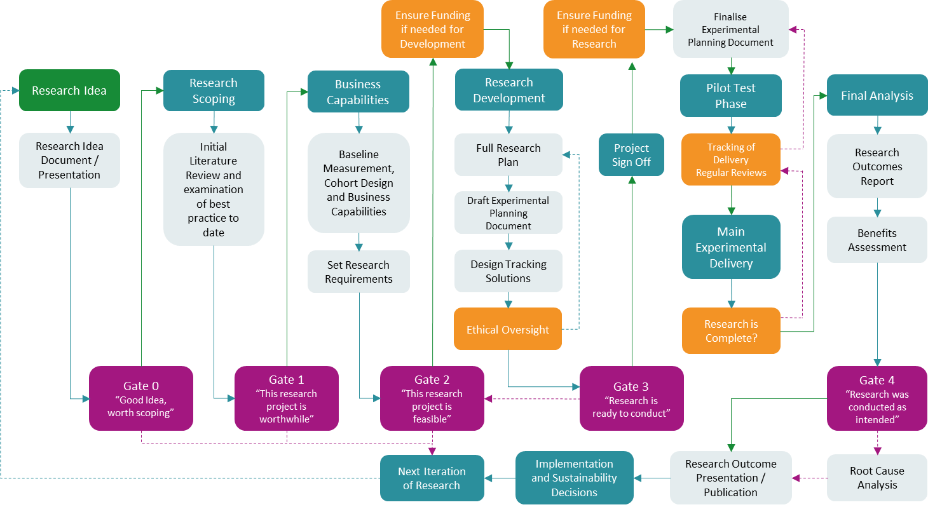
Research Project Lifecycle
Reference: Olphin, T.P.A. (2023). Research Project Lifecycle: A Structured Approach to Conducting Research in the Public Sector. Reading, UK: Thames Valley Violence Reduction Unit. @ Crown Copyright 2023

Slide 8
To reference, please use:
Olphin, T.P.A., (2023). Research Project Lifecycle: A Structured Approach to Conducting Research in the Public Sector, Reading, UK: Thames Valley Violence Reduction Unit
© Crown Copyright 2023. This information is licensed under the Open Government Licence v3.0

Slide 9
Debunking Myths:
RCTs
Big
Complicated
Expensive
Take ages to run
Difficult
Not something we can do

Slide 10

Experiments can be cheap and simple to run
Experiments run in all areas of our lives, and we are likely subject to them each and every day
  Which colour button are you more likely to click on
  Whether a price drop makes you more likely to buy a product
Experiments can have a massive range of complexity
  From simple nudge trials (e.g. paying taxes on time)
  To trials of alternatives to prosecution that might require legislation changes (e.g. Project CARA)

Slide 11
Benefits of keeping trials compact
Faster Results
Easier to manage
Less expensive
More things can be tested
Efficient Delivery is more likely to be implemented
Minimises testing requirement for ethics conversations

Slide 12
Some Key Concepts for Keeping RCTs Small
Keep It Simple
More likely to have an impact = Smaller experiment needed to test
There are many different ways of solving a problem

Slide 13
Some things you need to ensure
Strong design and proper planning
Ability to make sure treatment and control are as desired
Delivery is tracked
Access to outcome data
It is much easier to do this when the elements of the trial are within your zone of control – harder for external evaluators to keep costs down
Be inventive… Consider ways to get same results from something smaller

Slide 14
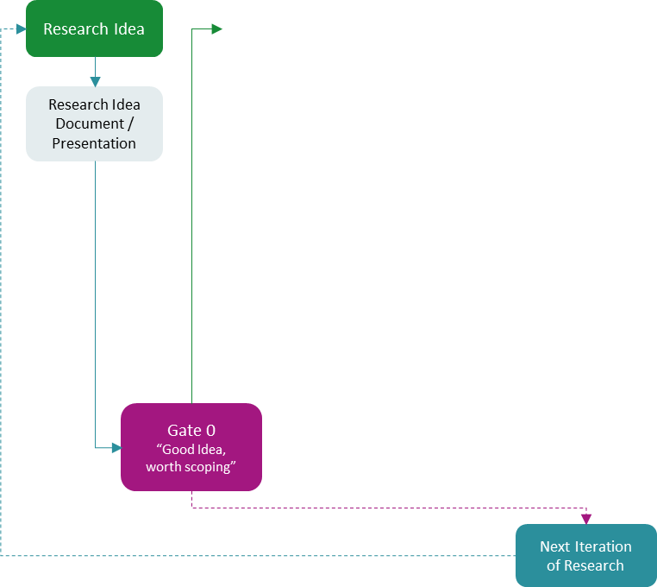
Ideas and Gate 0
“One of the most valuable things we can do to start with is acknowledge where we know nothing”
Both exciting and terrifying… most things delivered in the public sector have not been tested well
Encourage many ideas, some will naturally turn out to be smaller
Find areas of boom and bust funding
Using something that already exists, but too many cases to work with
Untested interventions that partners are about to start anyway

Slide 15
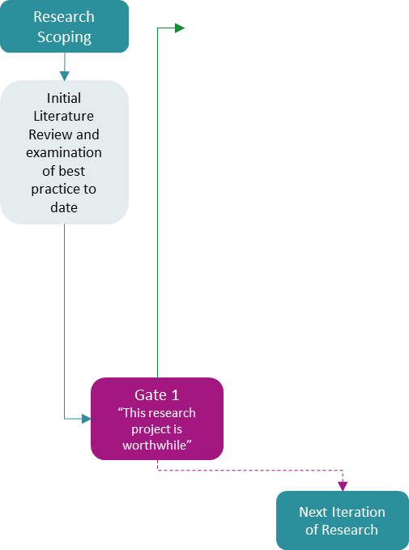
Research Scoping and Gate 1
“More likely to have an impact = Smaller experiment needed to test”
Design the best intervention you can, based on prior evidence:
  Use existing literature reviews as a base
  Rapid evidence review is possible to do swiftly, make sure to summarise detail
  Out of the evidence that is strongest:
    What works best, what works less?
    What power is likely
    What cohorts have been most effective
    How should it be designed?
    What are the elements that would make the best possible intervention
    Pay attention to context
      “Cambridge is not Chicago”

Slide 16
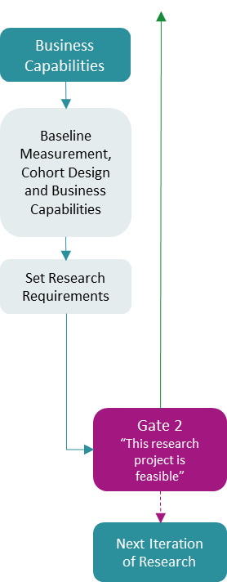
Business Capabilities and Gate 2
“More likely to have an impact = Smaller experiment needed to test”
“The fundamentals of research are the most important part: Spending time on baseline measurements and planning saves far more time and effort later”
Maximise Likely Effect Size
Design the best cohort you can, based on prior evidence
  Identify cohorts with higher likelihood of the unwanted outcome?
  Ideally avoid expert judgment identification
  Which groups are more likely to be paid for afterwards?
Make sure you can actually deliver the intervention
  Two small complete trials beats one unfinished trial
  Partner up with other areas and share the load
  What caseloads can be managed – Effective Staffing

Slide 17
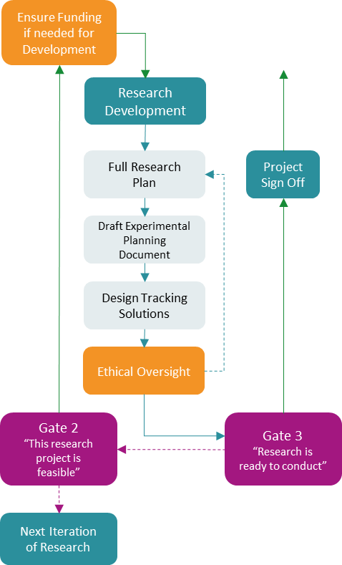
Research Design and Gate 3
“There are many different ways of solving a problem”
Be inventive
Most efficient mechanism of delivery (maximise your reach for the money)
Be clear what you are testing and keep it simple
Choose something you can deliver (in your zone of control)
Most ethical version of what can be delivered; often considering this helps to make it smaller
Accurate tracking ensures you find out early if things are not going to plan
More uptake (less dropout)
  Design out barriers
Realistic environment
  More similar to business as usual, often more likely to be delivered
  It can make it more tricky to find a good way, it can also allow for some interesting free experiments
Motivated delivery
  If the people delivering the intervention believe in it, they are more likely to keep to it

Slide 18
A Personal Aim
Many ideas, scoped at gate 3
Ready to go when we have
  Funding
  No overlap
  Political Desire
Avoid cohort overlap and trial overlap
  The more tests you have, the more complications there are with tracking and ensuring no overlap of trials, but it is possible
  Pause here if not ready yet
Imagine as a funder always getting well scoped trials, with evidence behind choices that have been made, and confidence behind delivery
Futures scanning can allow us to prioritise research areas that are likely to have funding released, and trials can be ready when this happens

Slide 19
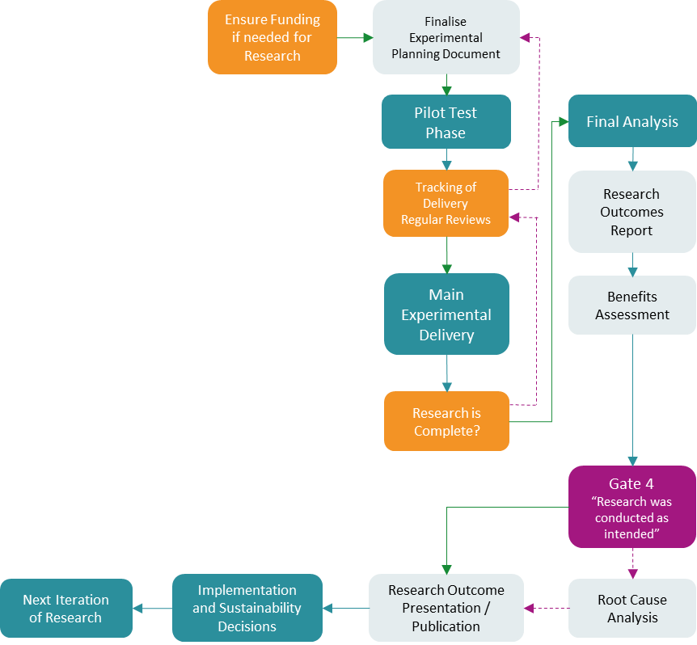
Delivery and Gate 4
Run Pilot Tests
  Ensure realistic caseloads to be able to deliver a good service
  Spot issues early
Interim Analysis can allow for earlier results
Avoid scope creep
Learn from your mistakes, and allow others to as well
Share what you learned, and make it more likely that more research will be wanted

Slide 20
Research Project Lifecycle
Reference: Olphin, T.P.A. (2023). Research Project Lifecycle: A Structured Approach to Conducting Research in the Public Sector. Reading, UK: Thames Valley Violence Reduction Unit. @ Crown Copyright 2023

Slide 21
Acknowledging Potential to be Underpowered
Don’t want to waste resources running things that would never show an effect, but…
No trials run means no knowledge gained
It is better to have some trials that give knowledge, and some that fail
Acknowledge weakness
  Failing to find an effect may not mean that it doesn’t work
Don’t over claim negative findings

Slide 22
Small, simple or inexpensive does not always mean underpowered
Nudge based campaigns can be run very inexpensively
Taking the time to make sure the delivery is as efficient as possible often just reduces cost
Giving an effective intervention to a cohort with likely outcome can require very small numbers

Slide 23
Some additional thoughts…
What are the opportunities you could exploit?
How can you make it most efficient whilst being externally generalisable?
Giving thought to it up front
There is also an important place for qualitative research
  When we use it meaningfully
  Can help to get an idea of making something that will work better

Slide 24
A Focused Deterrence Example

Slide 25
A Focused Deterrence Example
Maybe needs renaming to long-term contextual problem solving, with procedurally just police support
Cohort
  Likely to reoffend
  Motivated delivery
Intervention
  Likely to show an impact
  Problem solving approach paired with procedural justice
Results at 6 months
  All measures in the right direction, with statistically significant decrease of 57% in knife offences as suspects

Slide 26
Contact
Tori Olphin, M.B.E.
Head of Data Science, Research and Evaluation
Thames Valley Violence Prevention Partnership
tori.olphin@thamesvalley.police.uk
+447921 808988

