Slide 1


Wales Violence Prevention Unit
Emergency Department Violence Prevention Team
Daniel Jones
Interim Head of the VPU
South Wales Police and Crime Commissioners Office
Vicky Lee
Violence Prevention Advocate
Cardifff and Vale Health Board

Slide 2

Presentation content
Overview of Wales VPU
  VPU functions
  Public health approach
  Evidence led approach and violence surveillance system
Importance of hospital violence interventions
  The problem
  The solution
The Wales Violence Prevention Team
  Background
  Key features
  Support provided by VPT
  Benefits of VPT model
Evaluations
  Internal VPU process evaluation
  Independent Implementation and process evaluation
  Effectiveness and cost effectiveness evaluation

Slide 3
Wales Violence Prevention Unit
Multi agency team consisting of Criminal Justice Partners and Public Health staff
A South Wales VRU with a mission to develop a public health approach to prevent violence across all of Wales
Our work spans research and evaluation – violence surveillance – operational activity – commissioned services.
Website - https://www.violencepreventionwales.co.uk/
Twitter - https://twitter.com/WalesVPU

Slide 4





Wales VPU Functions
Research
Evaluation
Violence monitoring and surveillance
Policy and advocacy
Social marketing
Communications
Commissioned services
Operational activity

Slide 5
Violence prevention: using a public health approach
The four stages of a public health approach to violence prevention:
Considers the health of whole populations rather than individuals
Data-led
Evidence-based: Uses evidence to take a system-wide approach to promoting health and wellbeing and reducing health inequalities
Focused on prevention
Whole-system and multi-agency
Complements existing Criminal Justice and Specialist Service responses.
Know the facts
-What is the problem
-What are the causes
-Identify risk and protective factors
Explore the solutions
Adapt and scale up what works
Implement and evaluate
Snowdon et al., (2023) Wales Without Violence, Wales VPU, Public Health Wales, Cardiff

Slide 6
Violence surveillance – using health data to enhance what is known
Built upon a history of collaboration and partnership working, between PHW, SWPCC and SWP to prevent violence & recognise and respond to vulnerability in Wales a MoU and Wales-wide collaboration agreement was signed in 2015 between Policing, Criminal Justice Partners and Public Health Wales
As a result of the MoU, the South Wales violence surveillance system (SWVSS) was established in 2015 developing on from the Cardiff model & ISTV datasets.
The SWVSS, through the sharing of PI data, was able to cross-reference ED health data with police data to understand the number of individuals:
    presenting to multiple services as a result of violence.
    affected by violence who do not report to the police.
Memorandum of Understanding and Wales-Wide Collaboration Agreement
Principles of the agreement: Data sharing, analysis & evaluation Partnership working Prevention & early intervention Environmental & cultural influences Supporting people & communities

Slide 7
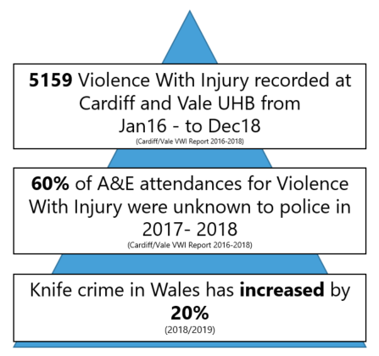
Using health data to inform violence prevention and intervention programmes
Considering health data can ‘fill in’ the gaps on what is known:
Using health data and cross-referencing to police data showed:

Slide 8
Importance of hospital violence interventions: the problem
Violence with injury:
~187, 584 people received emergency care for violence related injury in 2018 (England and Wales)
The National Violence Surveillance Network
High demand on health care services- cost and resource implications
Underreported to the police
  No support or protection measures
  Risk of reinjury and perpetration is greater.
60% of ED assault attendances in South Wales were not known to the police.
Grey et al., 2017
Health care providers well placed to identify victims and offer support
Due to current infrastructure patients often left
hospital with limited support or follow-up treatment.
Sivarajasingam V, Guan B, Page N, Peel E, Moore S, Shepherd J. Violence in England and Wales in 2019: An Accident and Emergency Perspective [Internet]. Cardiff; 2020.
Gray B, Barton E, Davies A, Long S, Roderick J, Bellis M. A shared data approach more accurately represents the rates and patterns of violence with injury assaults. J Epidemiol Community Heal. 2017;71(12):1218–24.
Notes:
Health care services, especially EDs, are particularly burdened by the consequences of violence, with a high volume of individuals requiring treatment for violence-related injuries.
The National Violence Surveillance Network- which utilised Cardiff Model/ISTV data identified ~187,584 people received emergency care for violence related injury in England and Wales in 2018
As you would expect, there is a high cost and resource implication for responding to violence-related injury.
However, violence with injury is significantly under-reported to the police. Research in Public Health Wales using the Cardiff model data highlighted that 59% of ED assault attendances were unknown to the police. In part, this is often because clinical staff are unable to disclose to police due to patient confidentiality.
Patients whose injuries are not reported to the police are unable to receive support and protective measures from the police. Often these people have high levels of vulnerability, and experience violence can increase the likelihood of future victimisation and perpetration.
While hospital staff are well placed to identify injuries and offer support and intervention, the infrastructure in health care doesn’t make this possible, and consequently patients are discharged with minimal support and follow-up.

Slide 9

Importance of hospital violence interventions: the solution
Hospital-based violence interventions have been established across UK- e.g., Redthread, Oasis, hospital navigators
Endorsed by the Home Office in the Serious Violence strategy for tackling serious violence
Nature and delivery of intervention varies across areas/ provisions
Offers support at a ‘teachable moment’- they’re at their most vulnerable and likely to engage.
Notes:
Hospital-based violence prevention interventions have been established across the UK- including services such as Red Thread and hospital navigators.
This type of intervention was promoted by the Home Office in the serious violence strategy.
While these services vary in their delivery, broadly speaking, these services seek to identify and intervene with children and young people involved in violence at what is considered a ‘teachable moment’, at a time they are most vulnerable and may be more inclined to engage with services to address their vulnerabilities.

Slide 10
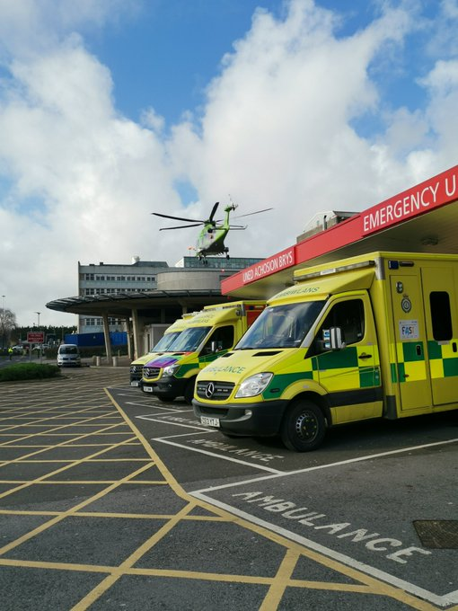
Background to the Violence Prevention Team (VPT)
Wales VPU funded the development and implementation in October 2019
Operating within the Emergency Department at the University Hospital Wales, a major trauma centre (since Aug 2020).
Aimed to engage with patients attending ED with violence-related injuries to:
  Improve police reporting
  Provide advice, support, and guidance to address vulnerabilities
  Encourage engagement with services
  Promote movement away from violence.
Notes:
In Wales, the Violence Prevention Unit (VPU) funded the development and implementation of a Violence Prevention Team (VPT) in October 2019, which was to operate within the ED in the University Hospital of Wales (UHW), Cardiff.
Previous work around the ACE agenda, and the link between vulnerability and crime created an appetite for the provision in Wales. This allowed the service to be set up with relative ease. The health board safeguarding lead worked with the VPU to establish a localised, needs-based provision. The intervention providers were given the autonomy to develop the service. The VPU provided the support to overcomes challenges/ blockers, and problem-solve.
The service was established to engage with patients who attend the ED with violence-related injuries, with the aim to improve police reporting, and provide advice, support and guidance to encourage engagement with services and promote movement away from violence.

Slide 11

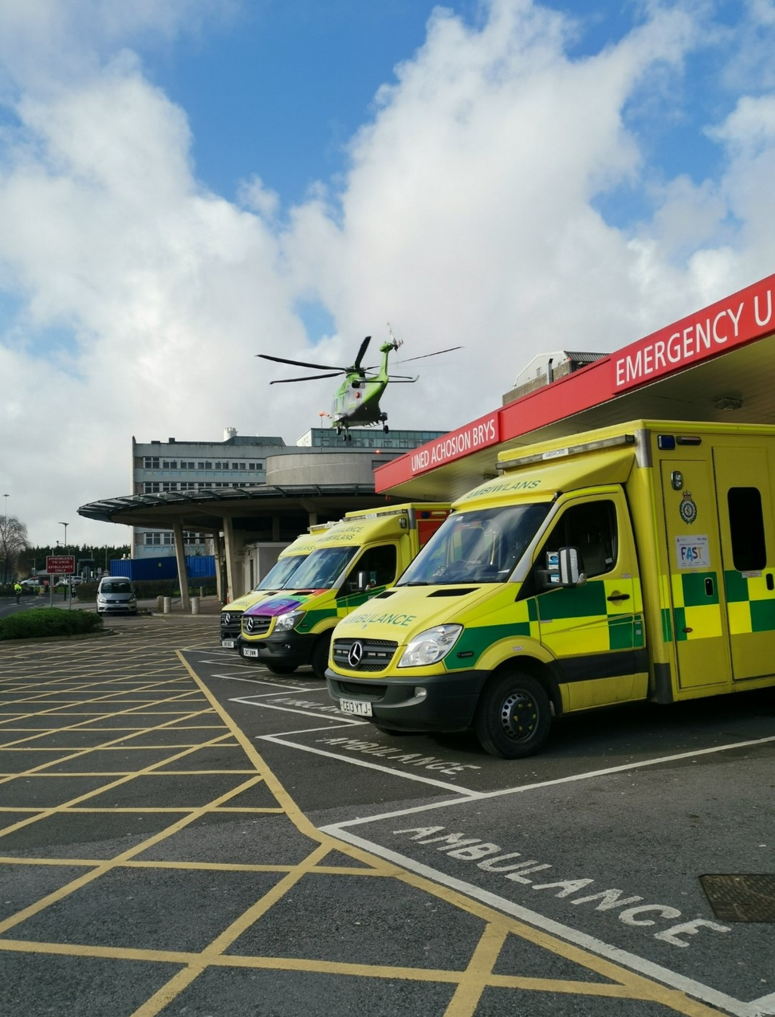
VIOLENCE
PREVENTION
TEAM
VPT
EST. 2019
We are a nurse/advocate led initiative based in the ED at the University Hospital of Wales.
We focus on delivering ADVICE, SUPPORT and GUIDANCE to patients of ANY AGE who have experienced Violence With Injury (VWI).
Our aim is to provide a PERSON CENTRED APPROACH to patient care. Each patient is assessed and provided with support that fits around their individual needs.
This allows each patient to make an informed decision on their care and their future
05

Slide 12


Patient attends
Hospital
Referrals received from
A&E/ Barry Minors /
Llandough Hospital
/ Alcohol Treatment Centre
Referrals received from
wards (ITU / Neuro / Major Trauma
Childrens Hosptial / MAX FAX/Dental)
Adolescent / Paediatric
Safeguarding Meetings
Mental Health / ‘CAMHS’
School / CLA Nurses
REFERRAL PROCESS
Swansea
VPT
VPT
Violence Prevention
Team

Slide 13


  Safeguard Regardless of Consent
WHAT WE DO
VPT
Patients
  Start the trust process
  Provide patients with information and resources to enable them to make informed decisions.
  Risk assessment/management, safety planning, provide advice and guidance.
  Link in with other health professionals (mental health, D&A, Homeless nursing team, Outpatient clinics)
  Provide community support for high risk patients under the age of 25
  Link the young person and their families to community based support services
  Safeguarding (MARF’s, AS1's, MARAC Referrals)
  Provide a whole family approach to preventing violence
Additional
  Training
  Identify trends
  Data
  Attend Meetings
  Report all knife/GSW related injuries to police

Slide 14

STATS
VPT
Annual SHORT-TERM costs of
Violence NHS Wales 46.6 Million
(2018/19)
43% of VPT referrals
are under 25
77% Engagement rate
The VPT’s age range -
Youngest 1yrs and
the oldest has been 88yrs
UHW ED treated 427
Knife/GSW related injuries
(2019-2023)

Slide 15

ACTION FOR
CHILDREN
VPT
  Safeguard CYP’s and build a trusting relationship
  Support CYP’s to appointments (e.g. Hospital, Court, YJP, Housing)
  Advocate for the CYP. Ensure their voice is heard.
  Act as appropriate adult when a young person is in custody (if required)
  Assess needs and make a plan of action/goals with to the CYP
  Act as the bridge into services . Help build relationships with other professionals
  Provide lead case/care planning management, including undertaking assessing, reviewing and managing risks
  Deliver specialist interventions with CYP & families on a 1:1/2:1 basis, group or community.
The VPT have referred over 114 CYP to Action for Children since the partnership began.
As a result of this support, the VPT could offer additional support to 3500 (1500 CYP) patients attending A&E.

Slide 16


CASE STUDY
VPT
18 year old Male
Learning Difficulties
  VPT contact - Fractured Jaw requiring surgery - Disclosed he’d been assaulted as he didn’t want to ‘drug run’ anymore.
  Previously been discussed in NRM and Human Trafficking MARAC.
  Victim of multiple assaults, including threats with firearms
  At risk of Committing or becoming victim of Homicide
  AFC work 2:1 due to risk posed to YP

Slide 17



Health Inclusion Nurse
Adult & YP
IDVA
Psych
Liaison &
CAMHS
Violence
Prevention
Team
Frequent
Attenders
RedCross
CYFANNOL HUB
VPT

Slide 18






Evaluations
Independent Implementation and Process evaluation
(Cardiff and Swansea)
Independent effectiveness and cost-effectiveness evaluation
(Cardiff and Swansea)
Internal process evaluation (Cardiff)
Notes:
We have numerous evaluations to provide a robust evidence base to support the delivery of the VPT, and to facilitate with sustainability.
This includes an:
Initial VPU internal process evaluation of the service operating in Cardiff- completed in 2021.
And two independent evaluations of the Cardiff and Swansea services, led by Cardiff University, including:
An implementation and process evaluation
An effectiveness and cost-effectiveness evaluation

Slide 19
VPU Internal Process Evaluation
Aim: Evaluate the development and implementation of the service and the nature and level of support provided to patients with violence-related injury.
Findings:
VPT successfully embedded into the hospital
An effective model for responding to patients established.
Positive outcomes emerged, including:
  Improved safeguarding
  Greater access to support for patients
  Improvements to staff knowledge, awareness and confidence
  Increased reporting to police
Evaluation needed to understand the impact of the service on patients, and cost benefit of service to obtain longer-term funding.
Evaluation completed during the pandemic, therefore does not capture changes in service delivery and demand.
Notes:
Carried out by VPU Public Health colleagues, this evaluation captured the initial development and implementation of the service, and the nature of support provided to patients attending ED with violence-related injury.
Some of the learning from that evaluation has featured throughout the presentation already, but broadly speaking, the findings revealed that:
Despite setting up at the start of COVID, the provision was successfully embedded within the hospital.
The VPT established an effective model for responding to patients –providing early intervention and prevention to address patient needs and underlying vulnerabilities, as well as more intensive support for children and young people at high risk from SOC/ county lines/ exploitations.
Positive outcomes have begun to emerge, including improvements in:
Safeguarding practices across the ED department - due to training from the VPT on violence and safeguarding, allowing for better identification of victims, assessment of risk, and increased referrals.
Greater access to support for patients -more patients have their needs and vulnerabilities assessed and are referred on to other services for support.
Improvements to staff knowledge, awareness, and confidence working with patients of violence related injury.
Increased reporting to the police
However, in order for the intervention to be sustained beyond the life expectancy of the VPU, a strong business case is needed, including evidence on the impact on patients, and cost-effectiveness of the service.
While this evaluation provided useful information of what works well within the service and what doesn’t, it was carried out during COVID, thus does not reflect delivery since lock down measures have been lifted, and we have since made changes to delivery of the intervention.

Slide 20
Process and Implementation evaluation
Led by Professor Simon Moore (Cardiff University), with YEF funding.
To evaluate the VPTs in South Wales- Swansea and Cardiff, including:
  How embedded the services are into the wider hospital
  Extent to which delivery model is adhered to
  How well intervention components are delivered.
  Reach of intervention for all violence related injury attendees
  Extent to which patients engage with intervention
  Extent to which parents are supported across health care provisions/ settings
  Perceived benefit of the intervention
  Similarities and differences between the two ED provisions
  Adaptations made across settings- and the context of this (e.g., difference in nature of demand).
Notes:
Funded by the YEF, who also provided funding towards the delivery of the VPT in Morriston hospital in Swansea. The evaluation is lead by Professor Simon Moore at Cardiff Uni.
This evaluation aimed to understand how the VPTs have been set-up and how they are currently working. The research questions were co-produced with the YEF, Home Office, VPU, and Public Health Wales.
Broadly speaking the research will aim to explore:
The extent VPTs have been embedded within hospital systems.
The intended delivery model has been adhered to.
How well the components of the model are delivered
The reach of the intervention for all ED assault attendances
Extent patients engage with the intervention
Development of hospital referral pathways and support across health care settings.
Perceived benefit of intervention
Similarities and differences across settings- and the context of these differences given interventions aim to address local needs (are place-based)

Slide 21
Methods
A mixed methods approach has been used, to include:
Scoping review | Of emergency care-based violence interventions and underpinning causal mechanisms of violence.
Document analysis | Of materials, including VPT job specifications and hospital Standard Operating Procedures.
Analysis of ED data | Descriptive analysis of routine ED data (anonymised and aggregated) - and comparing VPT ascertainment and engagement rates with number of assault attendees.
Qualitative interviews | ~60 stakeholders in South Wales, including those who work with and for the VPTs.
Notes:
As you can see, a range of methods are being used to evaluate the interventions, including:
A scoping review of ED based interventions.
Analysis of available documents pertaining to the service
Analysis of routine ED data and engagement.
Interviews with stakeholders

Slide 22





Effectiveness and cost-effectiveness evaluation
Led by Professor Simon Moore (Cardiff University)- with NIHR funding until March 2025
Does an ED based violence intervention programme reduce future emergency healthcare utilisation?
To assess the effectiveness and cost effectiveness of the VPTs using a broad range of routine databases. To answer the following:
Does involvement with a VPT reduce the likelihood of unscheduled ED re-attendance?
Do VPTs represent value for money?
Does the presence of the VPT improve ascertainment of assault-related-attendences in ED?
To understand the characteristics of individuals exposed to violence, and how violence impacts outcomes.
Notes:
Also led by Professor Simon Moore at Cardiff University, this evaluation received funding from the NIHR- National Institute of Health Research. There are numerous collaborators on this project.
This is a very complex evaluation, but put simply, the evaluation seeks to answer the question: Does an ED based violence intervention programme reduce future emergency healthcare utilisation?
This is a large-scale data linkage project bringing data together across numerous services in Wales, allowing us to establish a more extensive and longitudinal understanding of violence, and the vulnerabilities that features in the populations effected.
Initially the data linkage will seek to answer whether:
Involvement in VPT reduce the likelihood of unscheduled ED re-attendance.
VPTs represent value for money
Presence of VPTs improve ascertainment of assault-related attendance in Eds.
The project also aims to understand the characteristics of individuals exposed to violence and how violence in the environment effects individual outcomes.

Slide 23
Methods:
To link multiple datasets through SAIL- a Welsh databank in Swansea University that anonymises the data.
Project team working to put Police data across all Welsh forces into databank.
Data to be explored- Important to first understand the data and how individuals feature within it- we cannot just count events.
Explore cluster events that can lead to violence perpetration/ victimisation
Allows us to answer a multitude of questions which can be translated into practice/ decision making.
Data sets for linking include:
Police data (four Welsh Police forces)
Children and Family Court Advisory and Support Service Wales Family Justice Dataset
Children in Need Dataset
Emergency Department Dataset
Emergency Medical Retrieval and Transfer Service
Ministry of Justice: Data First. Magistrates' court defendant data, Crown Court defendant data, criminal courts and prisons data, prisoner custodial journey data, Family Court data.
Outpatient Referral Dataset
Patient Episode Data for Wales Dataset
Substance Misuse Dataset
Violence Prevention Team (Cardiff and Swansea) Datasets
General Practitioner Dataset
Notes:
Very briefly on the methods- this is a very complex process that will be developed along the way.
The SAIL database will be used to link data- this is a large databank in Swansea University- which hosts large datasets across different sectors.
The project team are working to put police data into the databank across the Four Police forces in Wales, which has never been achieved before.
This will be linked to a large number of data sets already held in SAIL. Examples of data sets including CAFCASS, ED, Outpatient referral data, substance misuse data, GP data, and MoJ magistrates court and crown court defendant data.
Data is anonymised. It is linked through a two-step process that allows person identifiable data remain separate from the core data (e.g., offence data).
A lot of work needs to be done to prepare the data and establish the methodology- including harmonising the datasets so they align.
It’s important to first understand the data and how people feature within it- for example, people may attend different health care settings for the same injury, including ED, outpatient services and primary physicians. Simply counting how many times a person features in the datasets can give an inaccurate picture of the number of injuries experienced. The team are establishing a methodology to ensure we do not duplicate injuries in the datasets.
In addition to answering the main questions, the research seeks to understand what events can lead to violence perpetration or victimisation. For example, whether there are a series of events that took place which may/may not be violence in itself or highlight risk individually, but when you look at them together, can signify high risk.
While data linkage is intended to support the evaluation, it provides us the opportunity to ask a multitude of questions. We will work with the forces to identify the priority questions, and to translate the data into strategic and operational delivery.
Evaluation March 2025. Interim report November 2023.

Slide 24
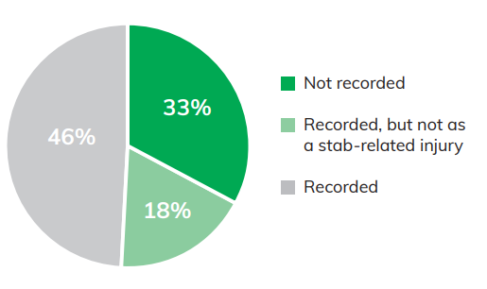
Cause for concern
Health data provided by the VPT (Cardiff) demonstrates significant discrepancies between the actual volume of patients who have attended the ED with stab-related injuries, and the number of patients captured within the Cardiff Model standardised dataset. Only 49% of stab injuries seen were accurately recorded within the standard dataset.
Number of stab related injuries recorded by the VPT captured within the Cardiff model dataset (July 2020 – June 2021)
Notes:
Health data provided by the VPT (Cardiff) demonstrates significant discrepancies between the actual volume of patients who have attended the ED with stab-related injuries, and the number of patients captured within the Cardiff Model standardised dataset. Only 49% of stab injuries seen were accurately recorded within the standard dataset, while 18% were miscoded as another form of injury. The further 33% of the patients with stab-related injuries were not recorded within the ED standard dataset.

